Slide 1
WORKSHOP
React Native
Developing cross-platform mobile apps
Notes:
Agenda:
What is React Native
Installation
View
Text
Stylesheet
Image
ScrollView
(P
Button
Alert
TextInput
State
Timer
(Countdown Timer)
Break
ListView
(ToDo List)
Asynchronous Storage
Navigation
(Money Management App)

Slide 2
View & Text

Slide 3
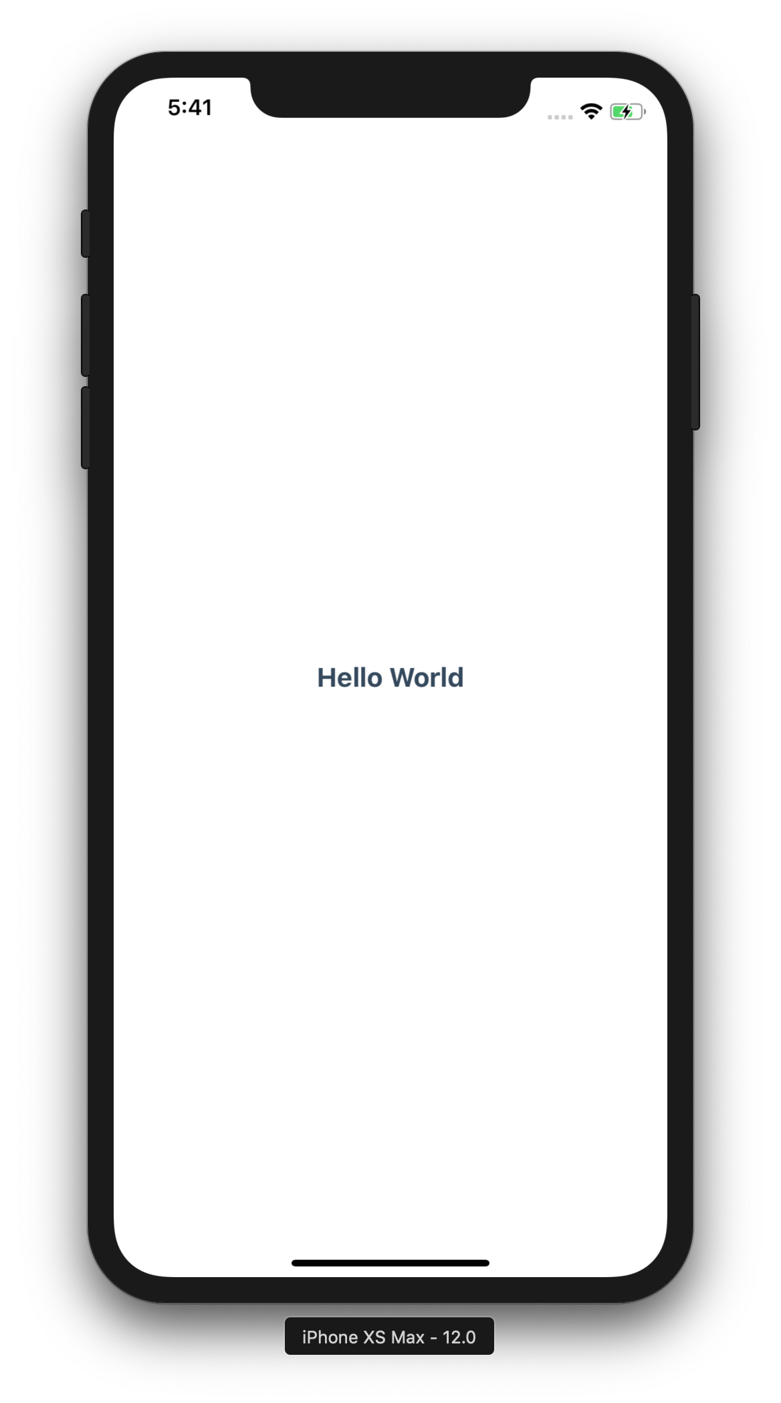
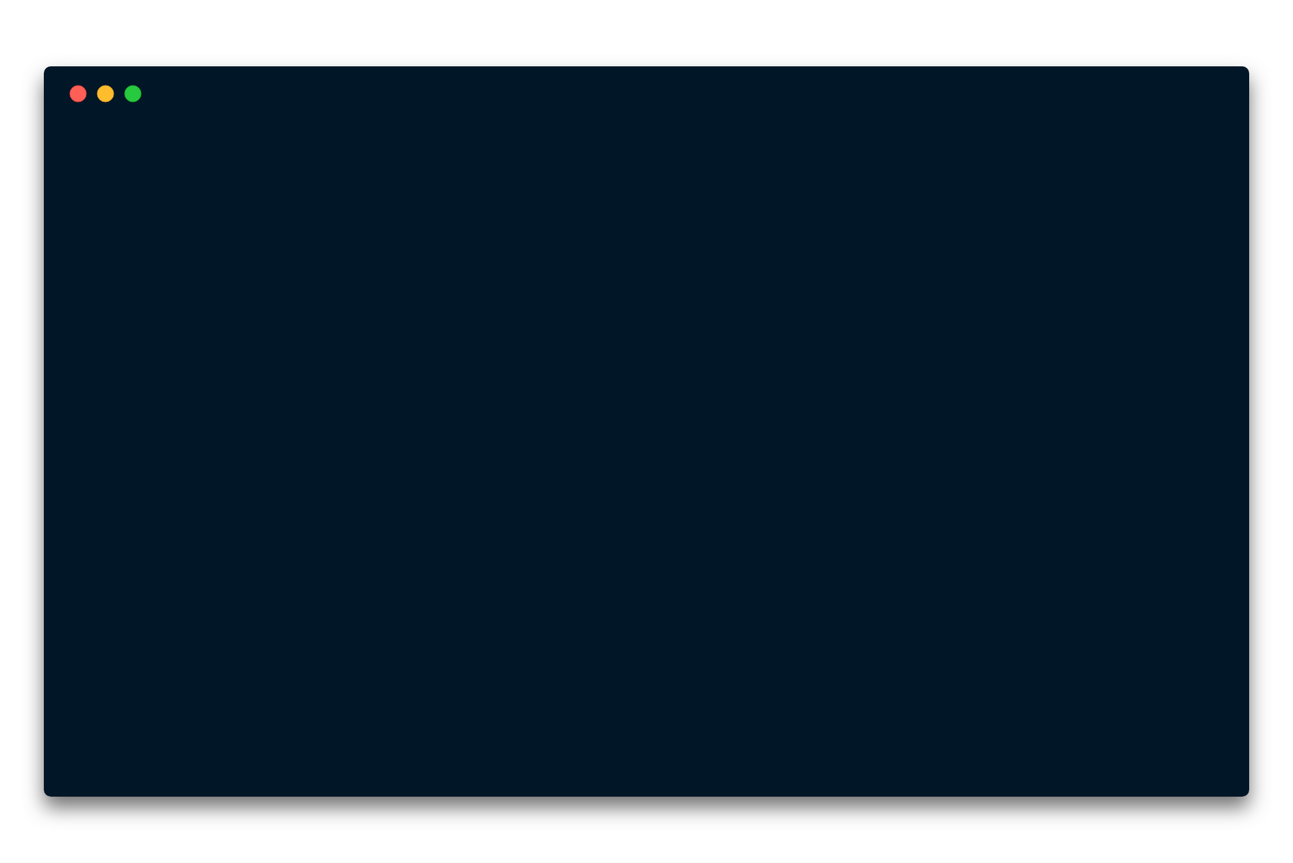
import * as React from 'react’;
import {
Text,
View
} from 'react-native’;
import styles from ‘./Styles’;
export default class App extends React.Component {
render() {
return(
<View style={styles.view}
<Text style={styles.text}>
Hello World
</Text>
</View>
);
}
}
import * as React from 'react’;
import {
Text,
View
} from 'react-native’;
import styles from ‘./Styles’;
export default class App extends React.Component {
render() {
return(
<View style={styles.view}>
<Text style={styles.text}>
Hello World
</Text>
</View>
);
}
}
import * as React from 'react';
import {
Text,
View
} from 'react-native';
import styles from ‘./Styles’;
export default class App extends React.Component {
render() {
return(
<View style={styles.view}>
<Text style={styles.text}>
Hello World
</Text>
</View>
);
}
}
main
import * as React from 'react’;
import {
Text,
View
} from 'react-native’;
import styles from ‘./Styles’;
export default class App extends React.Component {
render() {
return(
<View style={styles.view}>
<Text style={styles.text}>
Hello World
</Text>
</View>
);
}
}
import * as React from 'react’;
import {
Text,
View
} from 'react-native’;
import styles from ‘./Styles’;
export default class App extends React.Component {
render() {
return(
<View style={styles.view}>
<Text style={styles.text}>
Hello World
</Text>
</View>
);
}
}
import * as React from 'react’;
import {
Text,
View
} from 'react-native’;
import styles from ‘./Styles’;
export default class App extends React.Component {
render() {
return(
<View style={styles.view}>
<Text style={styles.text}>
Hello World
</Text>
</View>
);
}
}
import * as React from 'react’;
import {
Text,
View
} from 'react-native’;
import styles from ‘./Styles’;
export default class App extends React.Component {
render() {
return(
<View style={styles.view}>
<Text style={styles.text}>
Hello World
</Text>
</View>
);
}
}
view
Notes:
import * as React from 'react';
import {
Text,
View
} from 'react-native';
import styles from './Styles';
export default class App extends React.Component {
render() {
return (
<View style={styles.view}>
<Text style={styles.text}>
Hello World
</Text>
</View>
);
}
}

Slide 4
StyleSheet

Slide 5
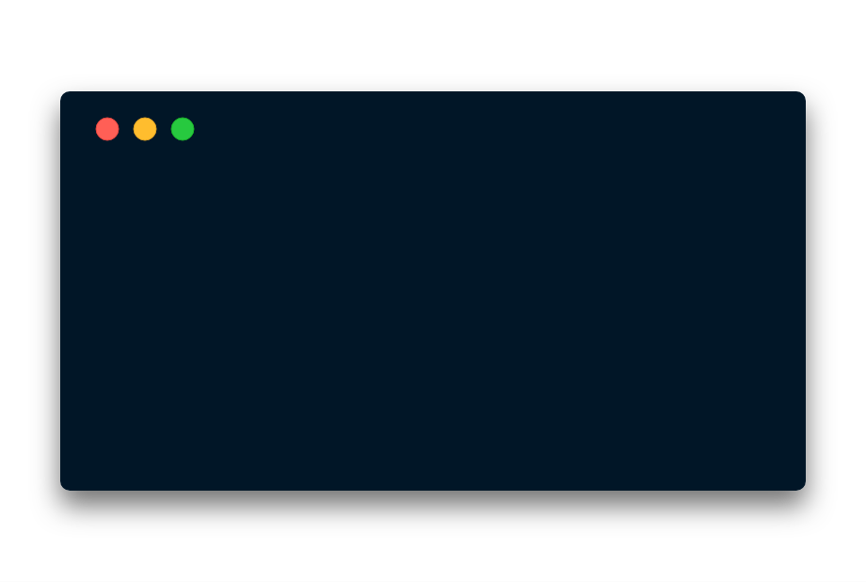
import { StyleSheet } from 'react-native'
export default StyleSheet.create({
text: {
margin: 24,
fontSize: 18,
fontWeight: 'bold’,
textAlign: 'center’,
color: '#34495e’
},
view: {
flex: 1,
flexDirection: ’column’,
justifyContent: 'center’,
alignItems: ’stretch’
}
});
import { StyleSheet } from 'react-native'
export default StyleSheet.create({
text: {
margin: 24,
fontSize: 18,
fontWeight: 'bold’,
textAlign: 'center’,
color: '#34495e’
},
view: {
flex: 1,
flexDirection: ’column’,
justifyContent: 'center’,
alignItems: ’stretch’
}
});
import { StyleSheet } from 'react-native'
export default StyleSheet.create({
text: {
margin: 24,
fontSize: 18,
fontWeight: 'bold’,
textAlign: 'center’,
color: '#34495e’
},
view: {
flex: 1,
flexDirection: ’column’,
justifyContent: 'center’,
alignItems: ’stretch’
}
});
import { StyleSheet } from 'react-native'
export default StyleSheet.create({
text: {
margin: 24,
fontSize: 18,
fontWeight: 'bold’,
textAlign: 'center’,
color: '#34495e’
},
view: {
flex: 1,
flexDirection: ’column’,
justifyContent: 'center’,
alignItems: ’stretch’
}
});
<View style={styles.view}>
<Text style={styles.text}>
Hello World
</Text>
</View>
<View style={styles.view}>
<Text style={styles.text}>
Hello World
</Text>
</View>
Notes:
import { StyleSheet } from 'react-native';
export default StyleSheet.create({
text: {
margin: 24,
fontSize: 18,
fontWeight: 'bold',
textAlign: 'center',
color: '#34495e'
},
view: {
flex: 1,
flexDirection: 'column',
justifyContent: 'center',
alignItems: 'stretch'
}
});

Slide 6
// HTML/CSS/JS
// React Native
.text {
margin: 24px;
font-size: 50px;
font-weight: bold;
text-align: center;
color: #34495e;
}
text: {
margin: 24,
fontSize: 18,
fontWeight: 'bold’,
textAlign: 'center’,
color: '#34495e',
}
<p class="text">
Hello World
</p>
<Text style={styles.text}>
Hello World
</Text>
Notes:
import { StyleSheet } from 'react-native';
export default StyleSheet.create({
text: {
margin: 24,
fontSize: 18,
fontWeight: 'bold',
textAlign: 'center',
color: '#34495e'
},
view: {
flex: 1,
flexDirection: 'column',
justifyContent: 'center',
alignItems: 'stretch'
}
});

Slide 7
Image & ScrollView

Slide 8
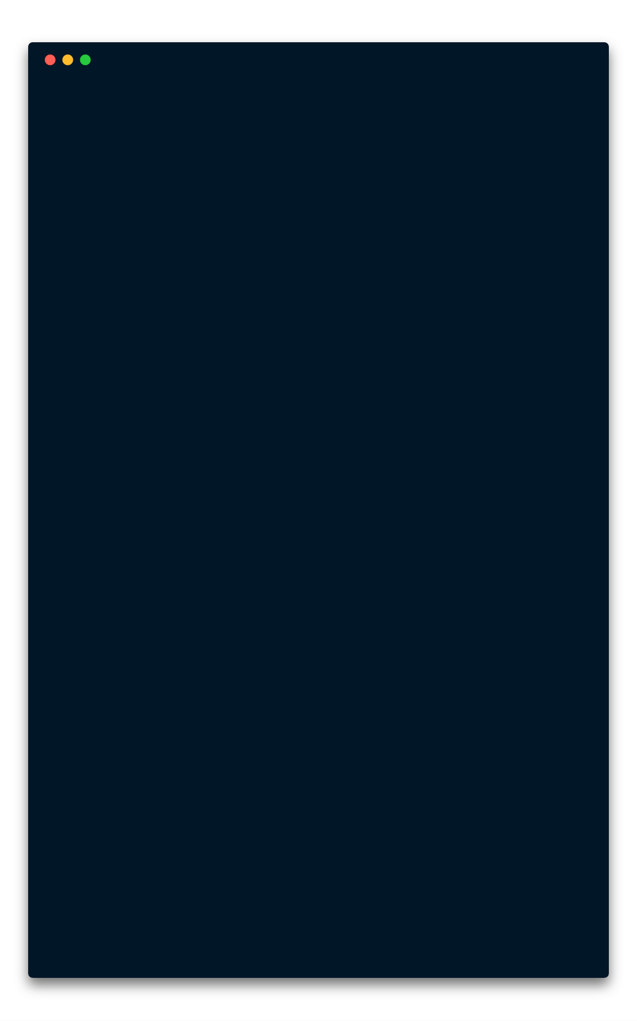
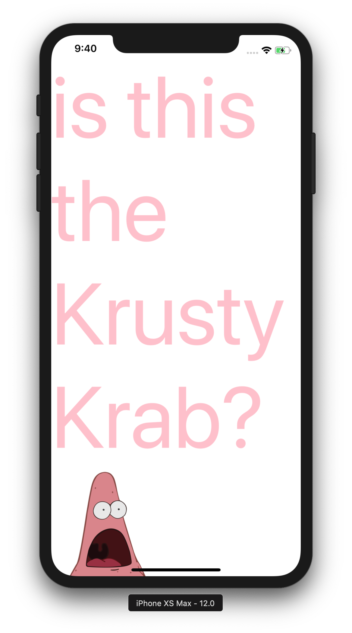
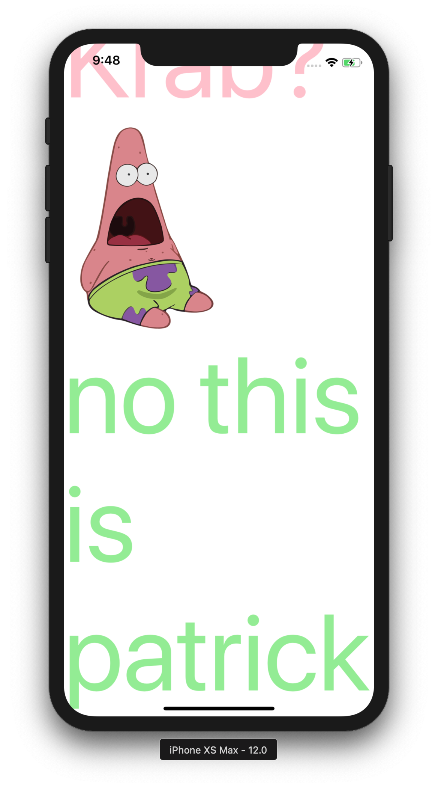
import * as React from 'react’;
import {
Image,
Text,
ScrollView
} from 'react-native';
export default class App extends React.Component {
render() {
return(
<ScrollView>
<Text style={{
fontSize: 130,
color: 'pink’,
paddingTop: 30
}}>
is this the Krusty Krab?
</Text>
<Image source={{
uri: "http://bit.do/patstar",
width: 200,
height: 250
}}/>
<Text style={{
fontSize: 130,
color: 'lightgreen’
}}>
no this is patrick
</Text>
</ScrollView>
);
}
}
import * as React from 'react’;
import {
Image,
Text,
ScrollView
} from 'react-native';
export default class App extends React.Component {
render() {
return(
<ScrollView>
<Text style={{
fontSize: 130,
color: 'pink’,
paddingTop: 30
}}>
is this the Krusty Krab?
</Text>
<Image source={{
uri: "http://bit.do/patstar",
width: 200,
height: 250
}}/>
<Text style={{
fontSize: 130,
color: 'lightgreen’
}}>
no this is patrick
</Text>
</ScrollView>
);
}
}
import * as React from 'react’;
import {
Image,
Text,
ScrollView
} from 'react-native';
export default class App extends React.Component {
render() {
return(
<ScrollView>
<Text style={{
fontSize: 130,
color: 'pink’,
paddingTop: 30
}}>
is this the Krusty Krab?
</Text>
<Image source={{
uri: "http://bit.do/patstar",
width: 200,
height: 250
}}/>
<Text style={{
fontSize: 130,
color: 'lightgreen’
}}>
no this is patrick
</Text>
</ScrollView>
);
}
}
import * as React from 'react’;
import {
Image,
Text,
ScrollView
} from 'react-native';
export default class App extends React.Component {
render() {
return(
<ScrollView>
<Text style={{
fontSize: 130,
color: 'pink’,
paddingTop: 30
}}>
is this the Krusty Krab?
</Text>
<Image source={{
uri: "http://bit.do/patstar",
width: 200,
height: 250
}}/>
<Text style={{
fontSize: 130,
color: 'lightgreen’
}}>
no this is patrick
</Text>
</ScrollView>
);
}
}
Notes:
import * as React from 'react’;
import { Image, Text, ScrollView} from 'react-native’;
export default class App extends React.Component {
render() {
return(
<ScrollView>
<Text style={{ fontSize: 130, color: 'pink', paddingTop: 30}}>
is this the Krusty Krab?
</Text>
<Image
source={{
uri: 'http://bit.do/patstar',
width: 200,
height: 250,
}}
/>
<Text style={{ fontSize: 130, color: 'lightgreen'}}>
no this is patrick
</Text>
</ScrollView>
);
}
}

Slide 9
Button & Alert

Slide 10
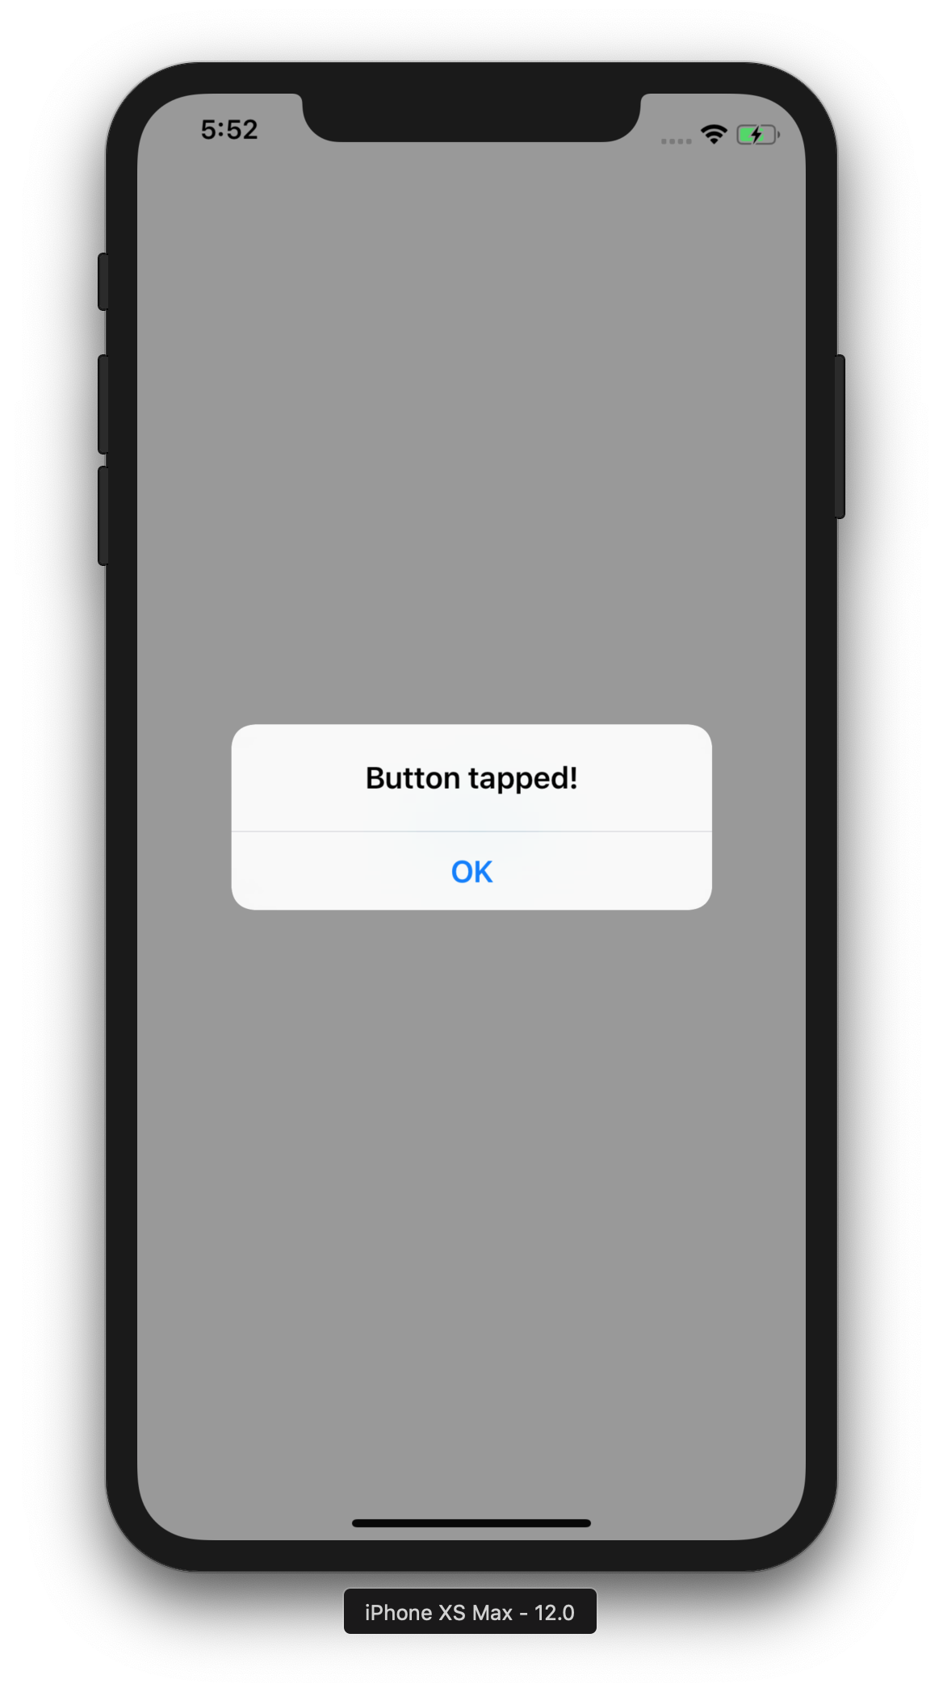
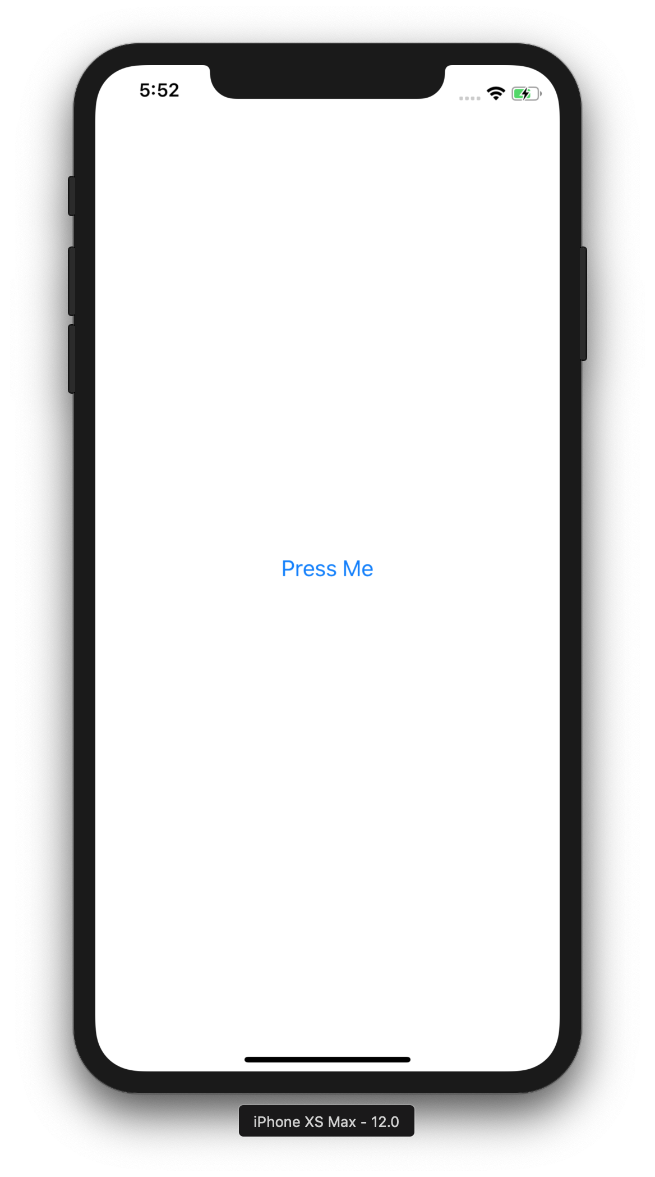
import * as React from 'react’;
import {
View,
Button,
Alert
} from 'react-native’;
import styles from ‘./Styles’;
export default class App extends React.Component {
pressButton = () => {
Alert.alert('Button tapped!’)
}
render() {
return(
<View style={styles.view}>
<
title="Press Me"
onPress={this.pressButton}
/>
</View>
);
}
}
import * as React from 'react’;
import {
View,
Button,
Alert
} from 'react-native’;
import styles from ‘./Styles’;
export default class App extends React.Component {
pressButton = () => {
Alert.alert('Button tapped!’)
}
render() {
return(
<View style={styles.view}>
<Button
title="Press Me"
onPress={this.pressButton}
/>
</View>
);
}
}
import * as React from 'react’;
import {
View,
Button,
Alert
} from 'react-native’;
import styles from ‘./Styles’;
export default class App extends React.Component {
pressButton = () => {
Alert.alert('Button tapped!’)
}
render() {
return(
<View style={styles.view}>
<Button
title="Press Me"
onPress={this.pressButton}
/>
</View>
);
}
}
import * as React from 'react’;
import {
View,
Button,
Alert
} from 'react-native’;
import styles from ‘./Styles’;
export default class App extends React.Component {
pressButton = () => {
Alert.alert('Button tapped!’)
}
render() {
return(
<View style={styles.view}>
<Button
title="Press Me"
onPress={this.pressButton}
/>
</View>
);
}
}
Notes:
import * as React from 'react';
import {
View,
Button,
Alert
} from 'react-native';
import styles from './Styles';
export default class App extends React.Component {
pressButton = () => {
Alert.alert('Button tapped!')
}
render() {
return (
<View style={styles.view}>
<Button
title="Press Me"
onPress={this.pressButton}
/>
</View>
);
}
}

Slide 11
// HTML/CSS/JS
// React Native
function onPress() {
alert('Clicked!')
}
onPress = () => {
Alert.alert(‘Tapped!')
}
<button onclick=”onPress()">
Press Me
</button>
<Button
title="Press Me"
onPress={this.onPress}
/>
Notes:
import { StyleSheet } from 'react-native';
export default StyleSheet.create({
text: {
margin: 24,
fontSize: 18,
fontWeight: 'bold',
textAlign: 'center',
color: '#34495e'
},
view: {
flex: 1,
flexDirection: 'column',
justifyContent: 'center',
alignItems: 'stretch'
}
});

Slide 12
TouchableOpacity & Image

Slide 13
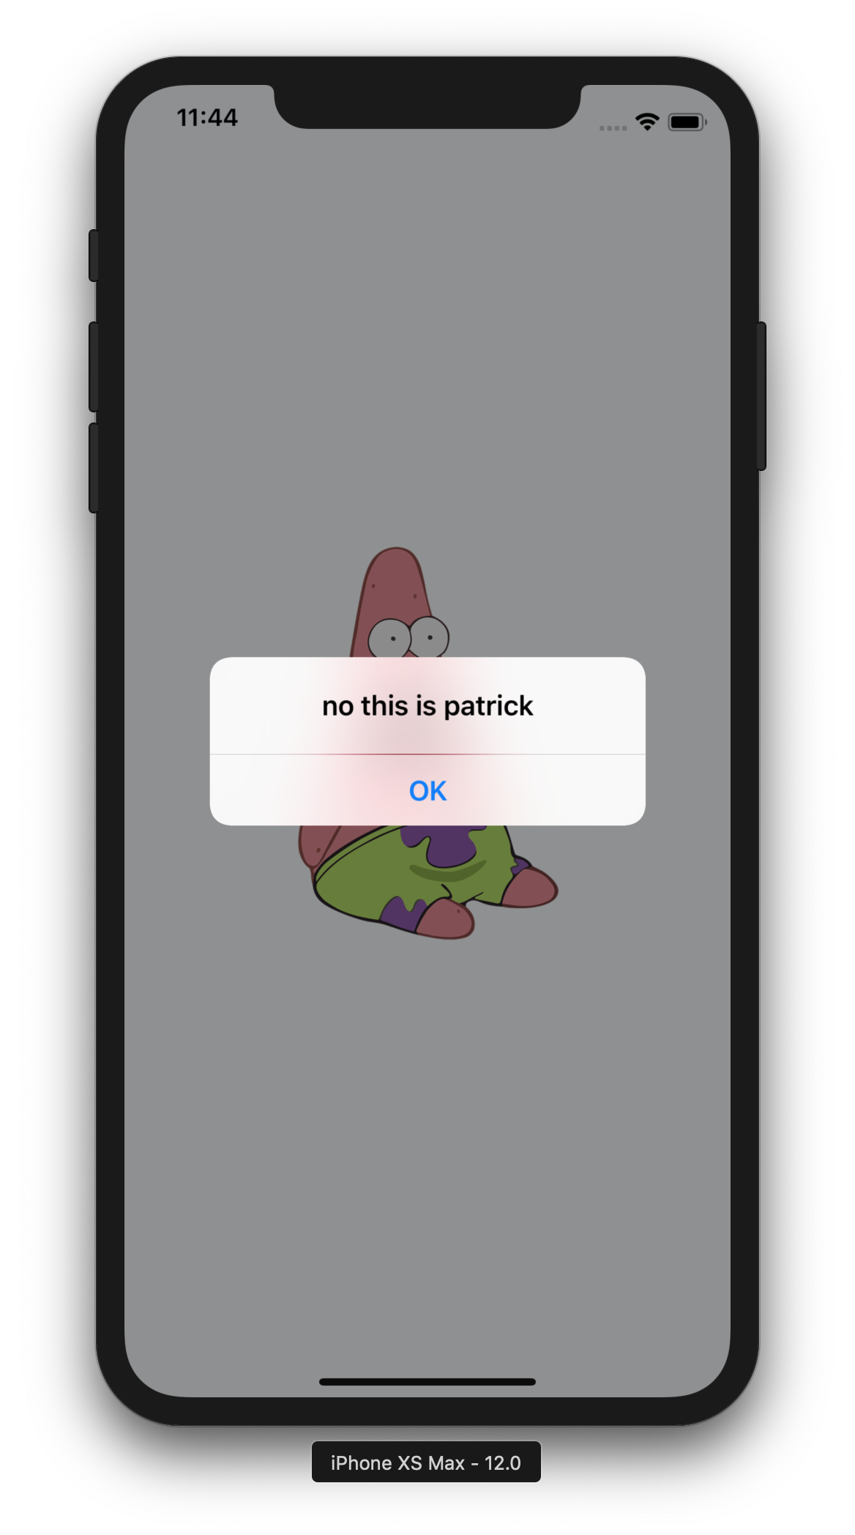
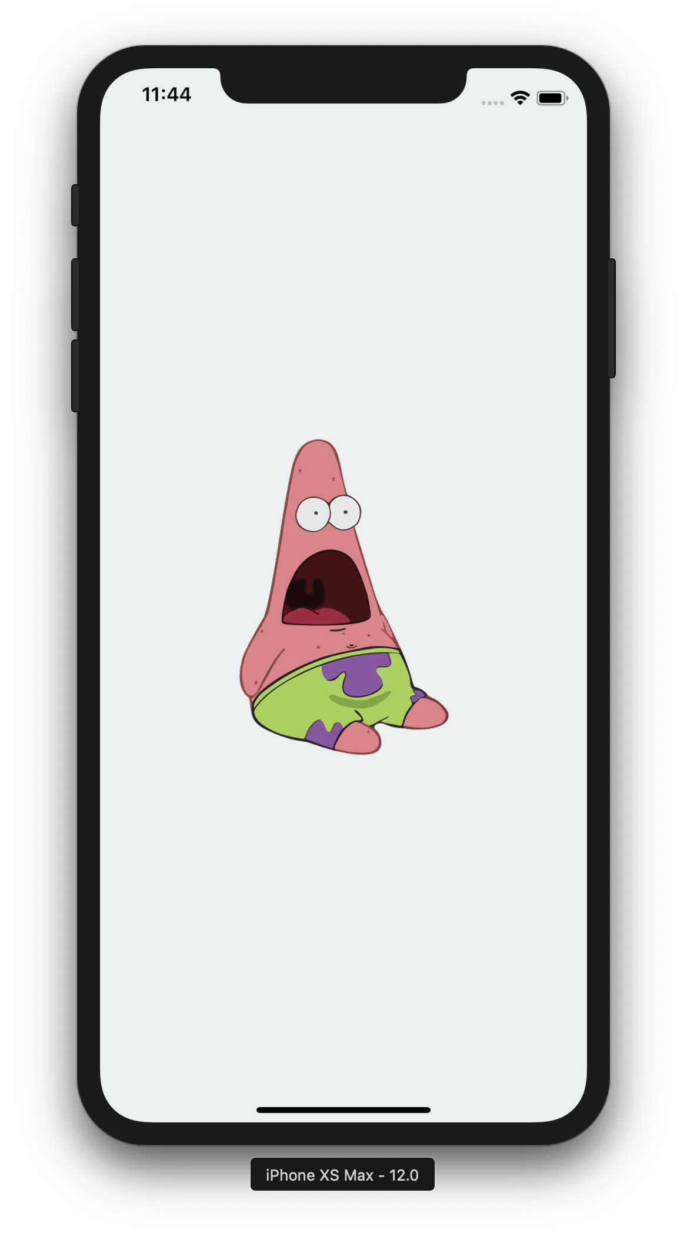
import * as React from 'react’;
import { Text, View, Alert, TouchableOpacity, Image}
from 'react-native';
export default class App extends React.Component {
showAlert = () => {
Alert.alert("no this is patrick")
}
render() {
return(
<View style={styles.view}>
<TouchableOpacity onPress={this.showAlert}>
<Image
source={{
uri: "http://bit.do/patstar",
width: 200,
height: 250
}}
/>
</TouchableOpacity>
</View>
);
}
}
import * as React from 'react’;
import { Text, View, Alert, TouchableOpacity, Image}
from 'react-native';
export default class App extends React.Component {
showAlert = () => {
Alert.alert("no this is patrick")
}
render() {
return(
<View style={styles.view}>
<TouchableOpacity onPress={this.showAlert}>
<Image
source={{
uri: "http://bit.do/patstar",
width: 200,
height: 250
}}
/>
</TouchableOpacity>
</View>
);
}
}
import * as React from 'react’;
import { Text, View, Alert, TouchableOpacity, Image}
from 'react-native';
export default class App extends React.Component {
showAlert = () => {
Alert.alert("no this is patrick")
}
render() {
return(
<View style={styles.view}>
<TouchableOpacity onPress={this.showAlert}>
<Image
source={{
uri: "http://bit.do/patstar",
width: 200,
height: 250
}}
/>
</TouchableOpacity>
</View>
);
}
}
Notes:
import * as React from 'react';
import {
View,
Button,
Alert
} from 'react-native';
import styles from './Styles';
export default class App extends React.Component {
pressButton = () => {
Alert.alert('Button tapped!')
}
render() {
return (
<View style={styles.view}>
<Button
title="Press Me"
onPress={this.pressButton}
/>
</View>
);
}
}

Slide 14
// HTML/CSS/JS
// React Native
<img
src=”image.png"
height="200"
width="250"
/>
<Image source={{
uri: ”image.png",
width: 200,
height: 200
}}/>
<p style="
font-size: 50;
color: blue;
">
This is a heading
</p>
<Text style={{
fontSize: 50,
color: 'blue'
}}>
Hello World
</Text>
Notes:
import { StyleSheet } from 'react-native';
export default StyleSheet.create({
text: {
margin: 24,
fontSize: 18,
fontWeight: 'bold',
textAlign: 'center',
color: '#34495e'
},
view: {
flex: 1,
flexDirection: 'column',
justifyContent: 'center',
alignItems: 'stretch'
}
});

Slide 15
TextInput & State

Slide 16
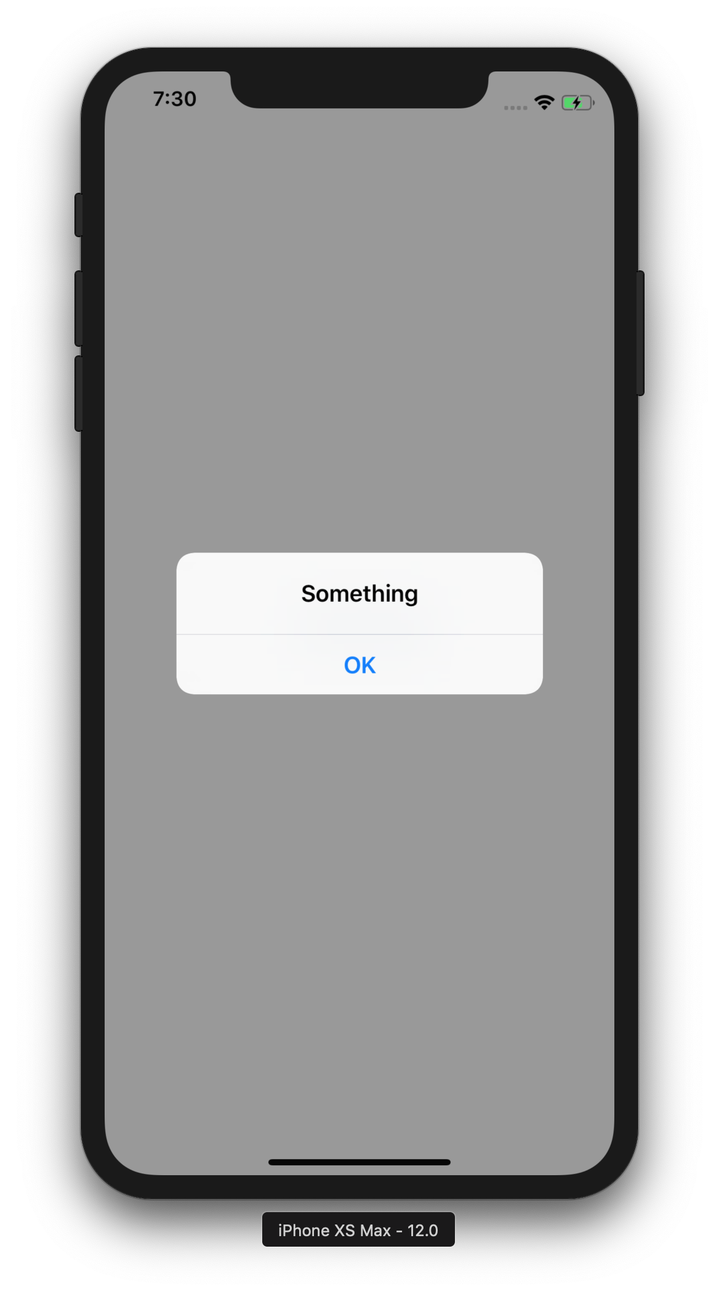
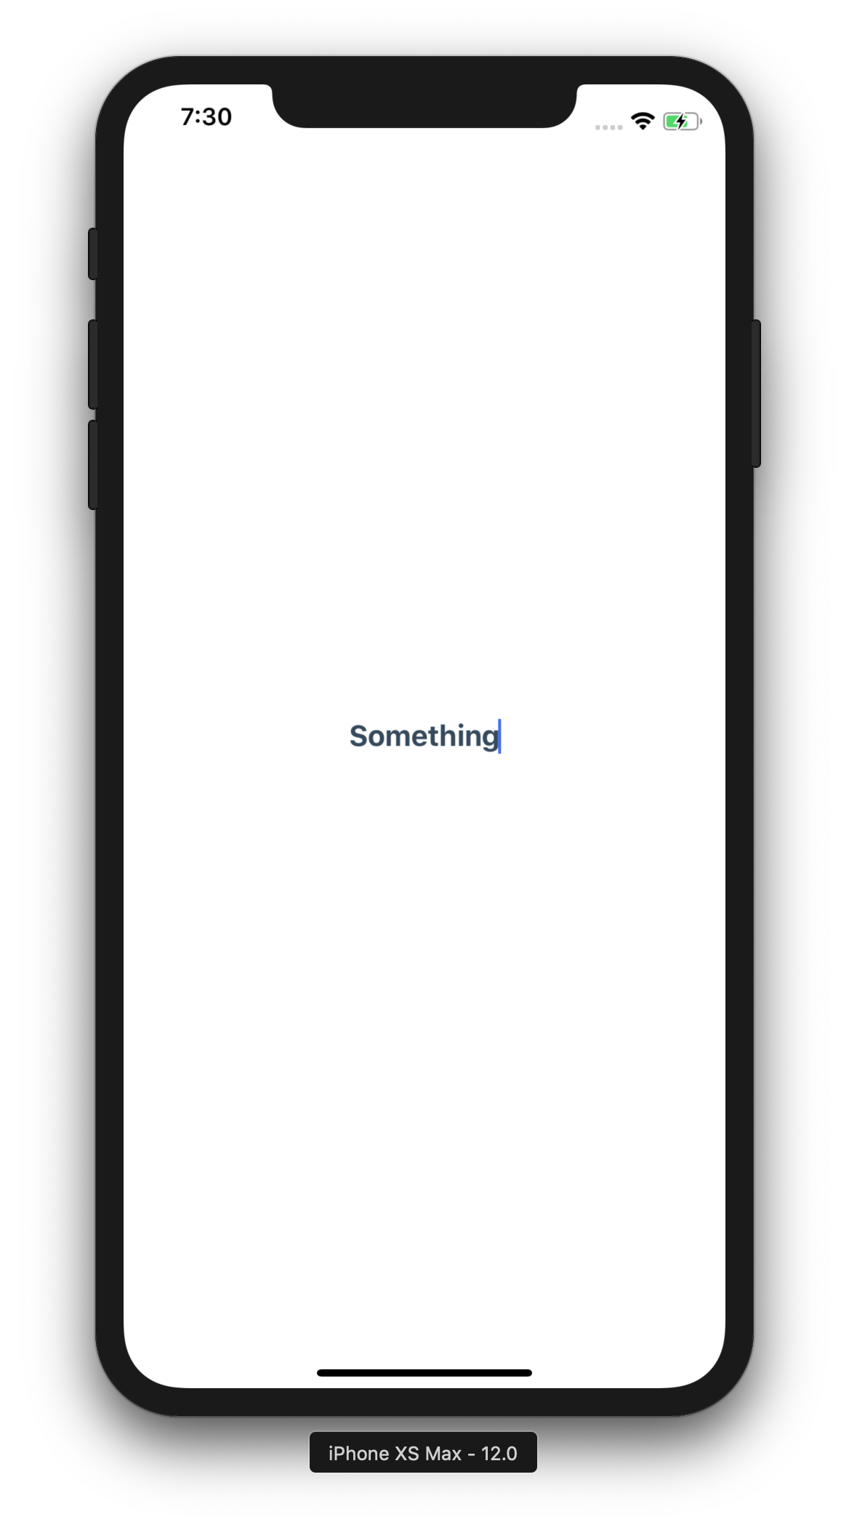
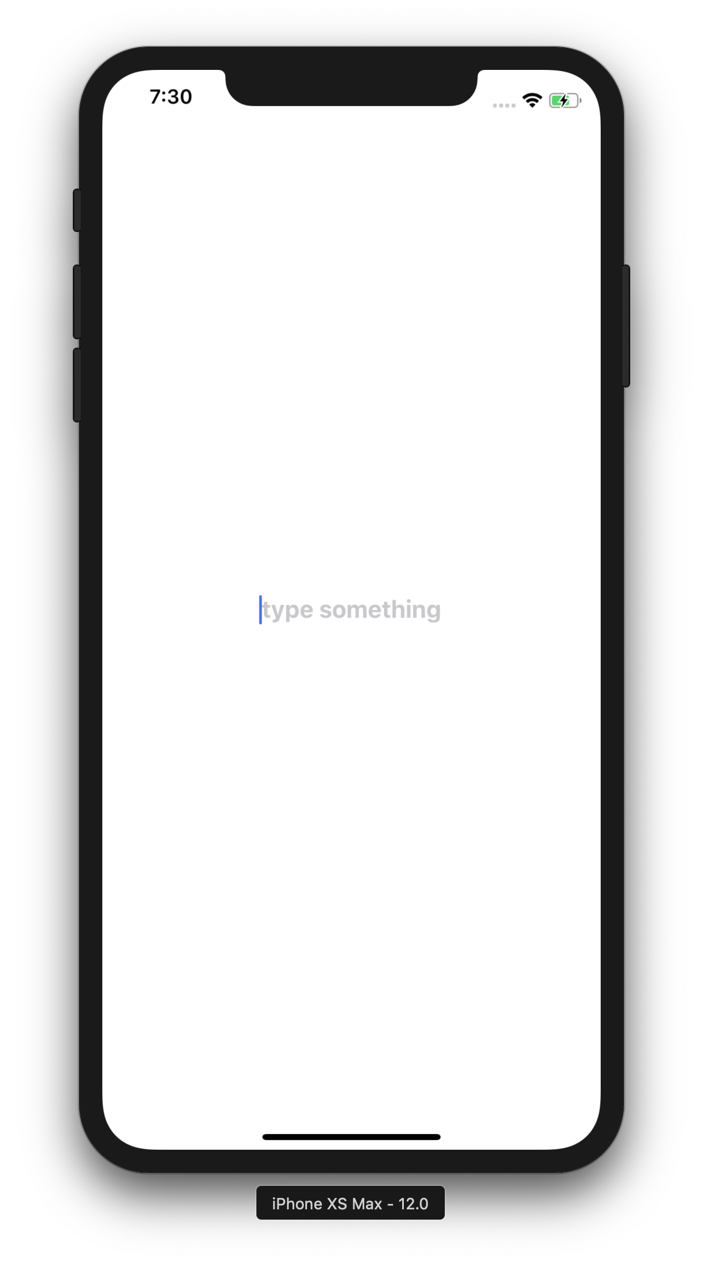
import * as React from 'react’;
import {
View,
Button,
Alert,
TextInput
} from 'react-native’;
import styles from './Styles';
export default class App extends React.Component {
render() {
return(
<View style={styles.view}>
<TextInput
placeholder="type something”
returnKeyType="done”
value={this.state.item}
onChangeText={this.storeText}
onSubmitEditing={this.showText}
style={styles.text}
/>
</View>
);
}
state = {item: ’’}
storeText = text => {
this.setState({
item: text
})
}
showText = () => {
Alert.alert(this.state.item)
} }
import * as React from 'react’;
import {
View,
Button,
Alert,
TextInput
} from 'react-native’;
import styles from './Styles';
export default class App extends React.Component {
render() {
return(
<View style={styles.view}>
<TextInput
placeholder="type something”
returnKeyType="done”
value={this.state.item}
onChangeText={this.storeText}
onSubmitEditing={this.showText}
style={styles.text}
/>
</View>
);
}
state = {item: ’’}
storeText = text => {
this.setState({
item: text
})
}
showText = () => {
Alert.alert(this.state.item)
} }
import * as React from 'react’;
import {
View,
Button,
Alert,
TextInput
} from 'react-native’;
import styles from './Styles';
export default class App extends React.Component {
render() {
return(
<View style={styles.view}>
<TextInput
placeholder="type something”
returnKeyType="done”
value={this.state.item}
onChangeText={this.storeText}
onSubmitEditing={this.showText}
style={styles.text}
/>
</View>
);
}
state = {item: ’’}
storeText = text => {
this.setState({
item: text
})
}
showText = () => {
Alert.alert(this.state.item)
} }
import * as React from 'react’;
import {
View,
Button,
Alert,
TextInput
} from 'react-native’;
import styles from './Styles';
export default class App extends React.Component {
render() {
return(
<View style={styles.view}>
<TextInput
placeholder="type something”
returnKeyType="done”
value={this.state.item}
onChangeText={this.storeText}
onSubmitEditing={this.showText}
style={styles.text}
/>
</View>
);
}
state = {item: ’’}
storeText = text => {
this.setState({
item: text
})
}
showText = () => {
Alert.alert(this.state.item)
} }
import * as React from 'react’;
import {
View,
Button,
Alert,
TextInput
} from 'react-native’;
import styles from './Styles';
export default class App extends React.Component {
render() {
return(
<View style={styles.view}>
<TextInput
placeholder="type something”
returnKeyType="done”
value={this.state.item}
onChangeText={this.storeText}
onSubmitEditing={this.showText}
style={styles.text}
/>
</View>
);
}
state = {item: ’’}
storeText = text => {
this.setState({
item: text
})
}
showText = () => {
Alert.alert(this.state.item)
} }
import * as React from 'react’;
import {
View,
Button,
Alert,
TextInput
} from 'react-native’;
import styles from './Styles';
export default class App extends React.Component {
render() {
return(
<View style={styles.view}>
<TextInput
placeholder="type something”
returnKeyType="done”
value={this.state.item}
onChangeText={this.storeText}
onSubmitEditing={this.showText}
style={styles.text}
/>
</View>
);
}
state = {item: ’’};
storeText = text => {
this.setState({
item: text
})
}
showText = () => {
Alert.alert(this.state.item)
} }
Notes:
import * as React from 'react';
import styles from './Styles';
import {
View,
Button,
Alert,
TextInput
} from 'react-native';
export default class App extends React.Component {
render() {
return (
<View style={styles.view}>
<TextInput
value={this.state.item}
returnKeyType="done"
onChangeText={this.storeText}
onSubmitEditing={this.showText}
placeholder="type something"
style={styles.text}
/>
</View>
);
}
constructor(props) {
super(props);
this.state = { item: '' };
}
storeText = text => {
this.setState({
item: text
})
}
showText = () => {
Alert.alert(this.state.item)
}
}

Slide 17
// HTML/CSS/JS
// React Native
var name = ”Jim";
var x = 5;
var isHuman = true;
state = {
name: ’Jim’,
x: 5,
isHuman: true
}
text = "hello world";
this.setState({
text: 'hello world'
})
alert(text)
Alert.alert(this.state.text)
Notes:
import { StyleSheet } from 'react-native';
export default StyleSheet.create({
text: {
margin: 24,
fontSize: 18,
fontWeight: 'bold',
textAlign: 'center',
color: '#34495e'
},
view: {
flex: 1,
flexDirection: 'column',
justifyContent: 'center',
alignItems: 'stretch'
}
});

Slide 18
Interval & Boolean

Slide 19
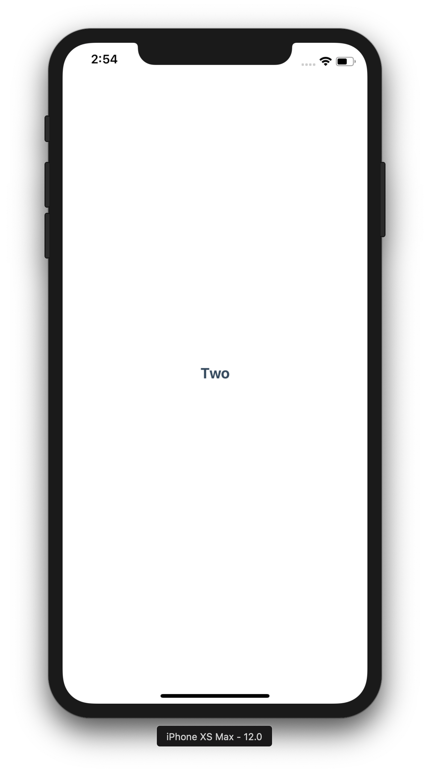
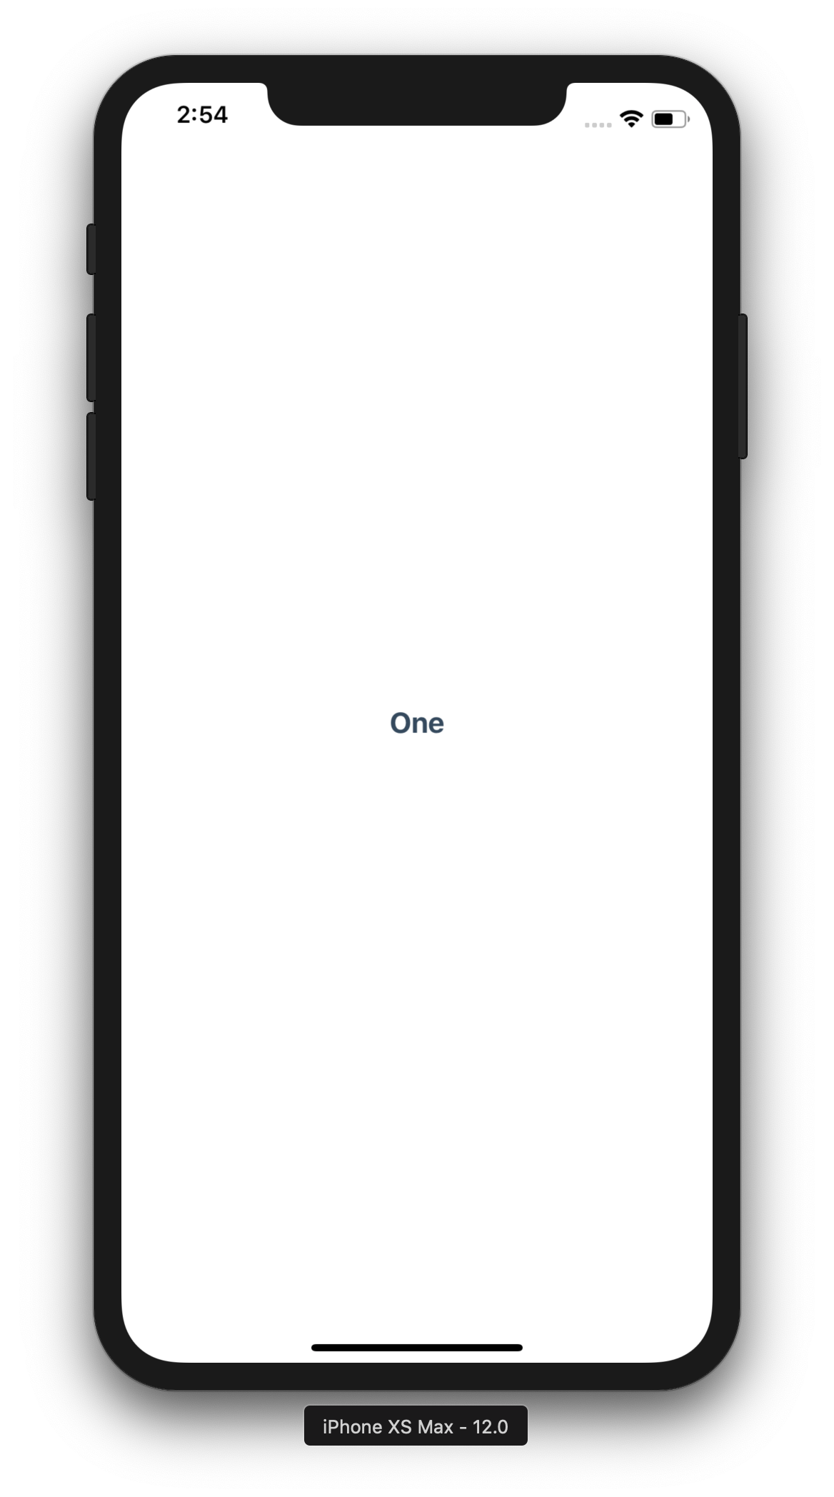
export default class App extends React.Component {
state = {
showText: true
}
componentDidMount() {
setInterval(() => {
this.setState((previousState) => {
return {
showText: !previousState.showText
};
});
}, 1000);
}
render() {
return(
<View>
{ this.state.showText ? (
<Text> One </Text>
) : (
<Text> Two </Text>
)}
</View>
);
}
}
export default class App extends React.Component {
state = {
showText: true
}
componentDidMount() {
setInterval(() => {
this.setState((previousState) => {
return {
showText: !previousState.showText
};
});
}, 1000);
}
render() {
return(
<View>
{ this.state.showText ? (
<Text> One </Text>
) : (
<Text> Two </Text>
)}
</View>
);
}
}
export default class App extends React.Component {
state = {
showText: true
}
componentDidMount() {
setInterval(() => {
this.setState((previousState) => {
return {
showText: !previousState.showText
};
});
}, 1000);
}
render() {
return(
<View>
{ this.state.showText ? (
<Text> One </Text>
) : (
<Text> Two </Text>
)}
</View>
);
}
}
export default class App extends React.Component {
state = {
showText: false
}
componentDidMount() {
setInterval(() => {
this.setState((previousState) => {
return {
showText: !previousState.showText
};
});
}, 1000);
}
render() {
return(
<View>
{ this.state.showText ? (
<Text> One </Text>
) : (
<Text> Two </Text>
)}
</View>
);
}
}
export default class App extends React.Component {
state = {
showText: true
}
componentDidMount() {
setInterval(() => {
this.setState((previousState) => {
return {
showText: !previousState.showText
};
});
}, 1000);
}
render() {
return(
<View>
{ this.state.showText ? (
<Text> One </Text>
) : (
<Text> Two </Text>
)}
</View>
);
}
}
export default class App extends React.Component {
state = {
showText: true
}
componentDidMount() {
setInterval(() => {
this.setState((previousState) => {
return {
showText: !previousState.showText
};
});
}, 1000);
}
render() {
return(
<View>
{ this.state.showText ? (
<Text> One </Text>
) : (
<Text> Two </Text>
)}
</View>
);
}
}
export default class App extends React.Component {
state = {
showText: true
}
componentDidMount() {
setInterval(() => {
this.setState((previousState) => {
return {
showText: !previousState.showText
};
});
}, 1000);
}
render() {
return(
<View>
{ this.state.showText ? (
<Text> One </Text>
) : (
<Text> Two </Text>
)}
</View>
);
}
}
export default class App extends React.Component {
state = {
showText: true
}
componentDidMount() {
setInterval(() => {
this.setState((previousState) => {
return {
showText: !previousState.showText
};
});
}, 1000);
}
render() {
return(
<View>
{ this.state.showText ? (
<Text> One </Text>
) : (
<Text> Two </Text>
)}
</View>
);
}
}
export default class App extends React.Component {
state = {
showText: true
}
componentDidMount() {
setInterval(() => {
this.setState((previousState) => {
return {
showText: !previousState.showText
};
});
}, 1000);
}
render() {
return(
<View>
{ this.state.showText ? (
<Text> One </Text>
) : (
<Text> Two </Text>
)}
</View>
);
}
}
Notes:
import * as React from 'react’;
import { Text, View} from 'react-native’;
import styles from './Styles';
export default class App extends React.Component {
state = {
isShowingText: true
}
componentDidMount() {
setInterval(() => {
this.setState((previousState) => {
return{ isShowingText: !previousState.isShowingText };
});
}, 1000);
}
render() {
return(
<View style={styles.view}>
{this.state.isShowingText ? (
<Text style={styles.text}>One</Text>
) : (
<Text style={styles.text}>Two</Text>
)}
</View>
);
}
}

Slide 20
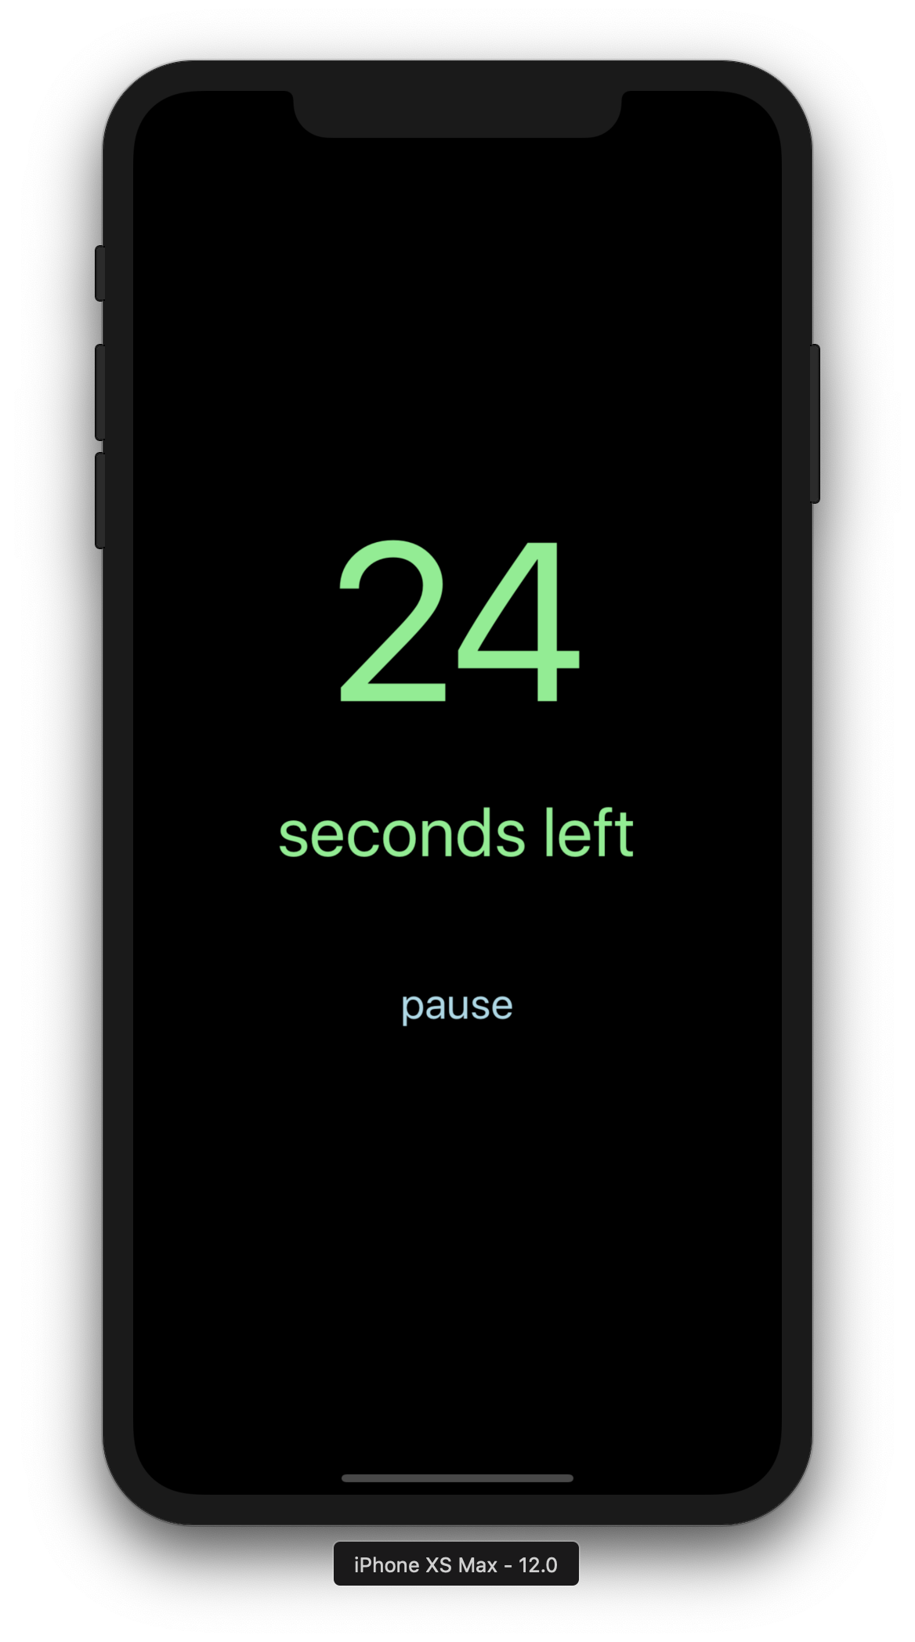
Activity: Countdown Timer

Slide 21
Props

Slide 22
FlatList

Slide 23
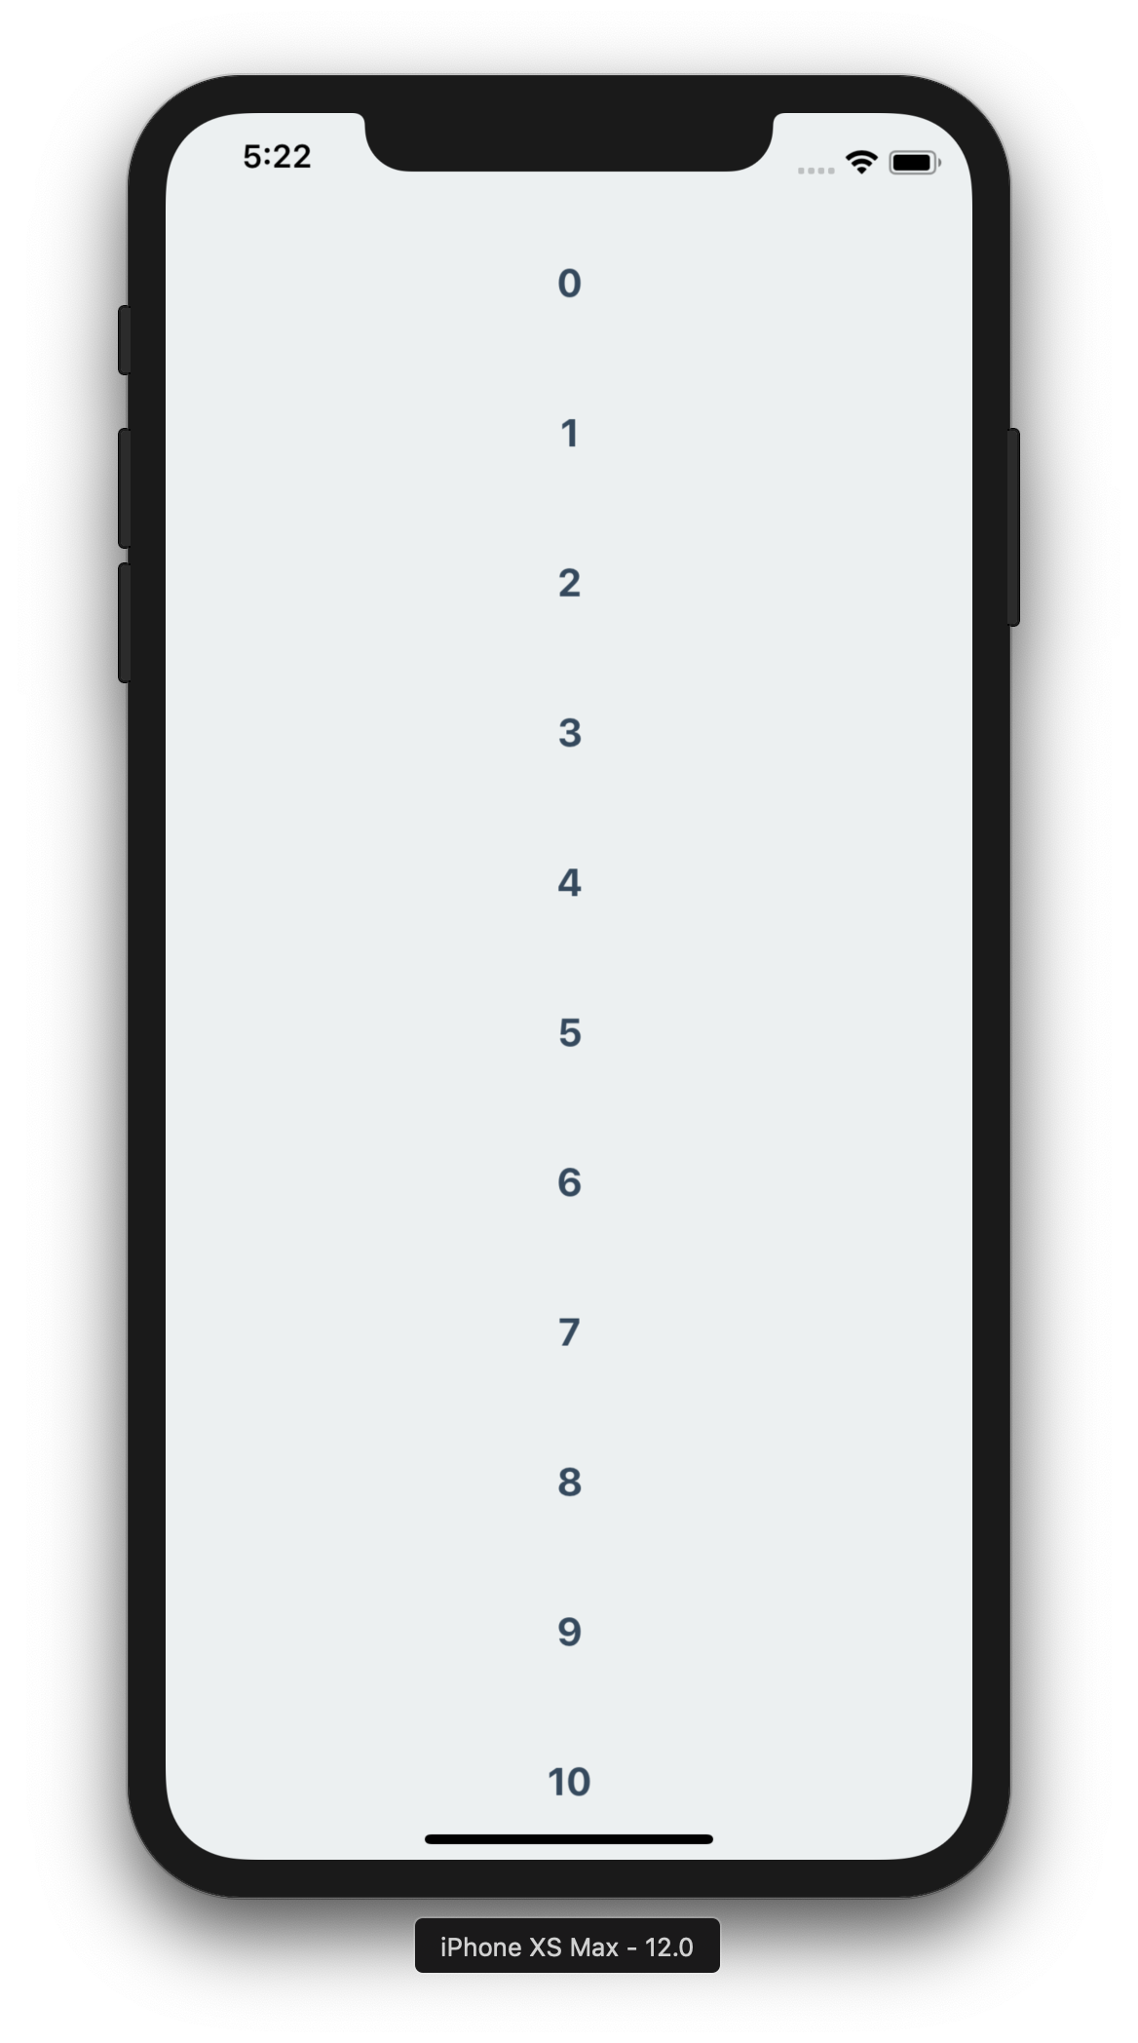
export default class App extends React.Component {
state = {
listData: Array.apply(null,{length: 100})
.map(Number.call, Number)
}
renderList = ({item}) => (
<Text style={styles.text}>{item}</Text>
)
render() {
return(
<View style={styles.view}>
<FlatList
data={this.state.listData}
renderItem={this.renderList}
/>
</View>
);
}
}
export default class App extends React.Component {
state = {
listData: Array.apply(null,{length: 100})
.map(Number.call, Number)
}
renderList = ({item}) => (
<Text style={styles.text}>{item}</Text>
)
render() {
return(
<View style={styles.view}>
<FlatList
data={this.state.listData}
renderItem={this.renderList}
/>
</View>
);
}
}
export default class App extends React.Component {
state = {
listData: Array.apply(null,{length: 100})
.map(Number.call, Number)
}
renderList = ({item}) => (
<Text style={styles.text}>{item}</Text>
)
render() {
return(
<View style={styles.view}>
<FlatList
data={this.state.listData}
renderItem={this.renderList}
/>
</View>
);
}
}
export default class App extends React.Component {
state = {
listData: Array.apply(null,{length: 100})
.map(Number.call, Number)
}
renderList = ({item}) => (
<Text style={styles.text}>{item}</Text>
)
render() {
return(
<View style={styles.view}>
<FlatList
data={this.state.listData}
renderItem={this.renderList}
/>
</View>
);
}
}
Notes:
import React, { Component} from 'react’;
import { ListView, Text, TextInput, View} from 'react-native’;
import styles from './Styles'
export default class App extends Component {
state = {
listItems: ["look","at","all","those","chickens"]
}
dataSource = newListView.DataSource({ rowHasChanged: (r1, r2) => r1 !== r2 })
renderRow = (rowData) => {
return(
<Text style={styles.text}>{rowData}</Text>
)
}
render() {
return(
<ListView
dataSource={this.dataSource.cloneWithRows(this.state.listItems)}
renderRow={this.renderRow}
style={styles.view}
/>
);
}
}

Slide 24
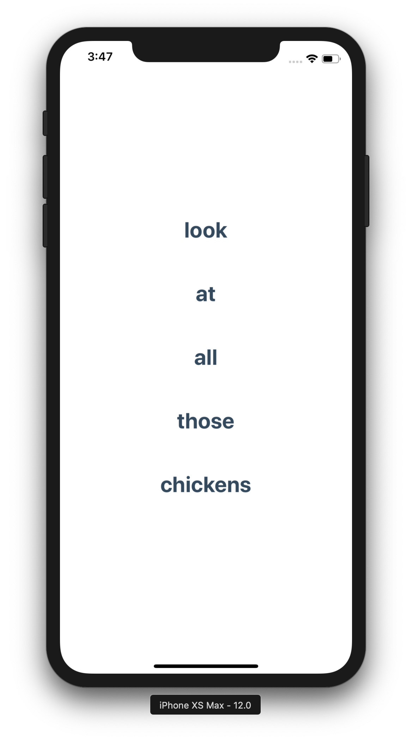
export default class App extends Component {
state = {
listItems: ["look","at","all","those","chickens"]
}
dataSource = new ListView.DataSource({
rowHasChanged: (r1, r2) => r1 !== r2 })
renderRow = (rowData) => {
return (
<Text>{rowData}</Text>
)
}
render() {
return(
<ListView
dataSource={
this.dataSource.cloneWithRows
(this.state.listItems)}
renderRow={this.renderRow} />
);
}
}
export default class App extends Component {
state = {
listItems: ["look","at","all","those","chickens"]
}
dataSource = new ListView.DataSource({
rowHasChanged: (r1, r2) => r1 !== r2 })
renderRow = (rowData) => {
return (
<Text>{rowData}</Text>
)
}
render() {
return(
<ListView
dataSource={
this.dataSource.cloneWithRows
(this.state.listItems)}
renderRow={this.renderRow} />
);
}
}
export default class App extends Component {
state = {
listItems: ["look","at","all","those","chickens"]
}
dataSource = new ListView.DataSource({
rowHasChanged: (r1, r2) => r1 !== r2 })
renderRow = (rowData) => {
return (
<Text>{rowData}</Text>
)
}
render() {
return(
<ListView
dataSource={
this.dataSource.cloneWithRows
(this.state.listItems)}
renderRow={this.renderRow} />
);
}
}
export default class App extends Component {
state = {
listItems: ["look","at","all","those","chickens"]
}
dataSource = new ListView.DataSource({
rowHasChanged: (r1, r2) => r1 !== r2 })
renderRow = (rowData) => {
return (
<Text>{rowData}</Text>
)
}
render() {
return(
<ListView
dataSource={
this.dataSource.cloneWithRows
(this.state.listItems)}
renderRow={this.renderRow} />
);
}
}
export default class App extends Component {
state = {
listItems: ["look","at","all","those","chickens"]
}
dataSource = new ListView.DataSource({
rowHasChanged: (r1, r2) => r1 !== r2 })
renderRow = (rowData) => {
return (
<Text>{rowData}</Text>
)
}
render() {
return(
<ListView
dataSource={
this.dataSource.cloneWithRows
(this.state.listItems)}
renderRow={this.renderRow} />
);
}
}
Notes:
import React, { Component} from 'react’;
import { ListView, Text, TextInput, View} from 'react-native’;
import styles from './Styles'
export default class App extends Component {
state = {
listItems: ["look","at","all","those","chickens"]
}
dataSource = newListView.DataSource({ rowHasChanged: (r1, r2) => r1 !== r2 })
renderRow = (rowData) => {
return(
<Text style={styles.text}>{rowData}</Text>
)
}
render() {
return(
<ListView
dataSource={this.dataSource.cloneWithRows(this.state.listItems)}
renderRow={this.renderRow}
style={styles.view}
/>
);
}
}

Slide 25
Asynchronous Storage

Slide 26
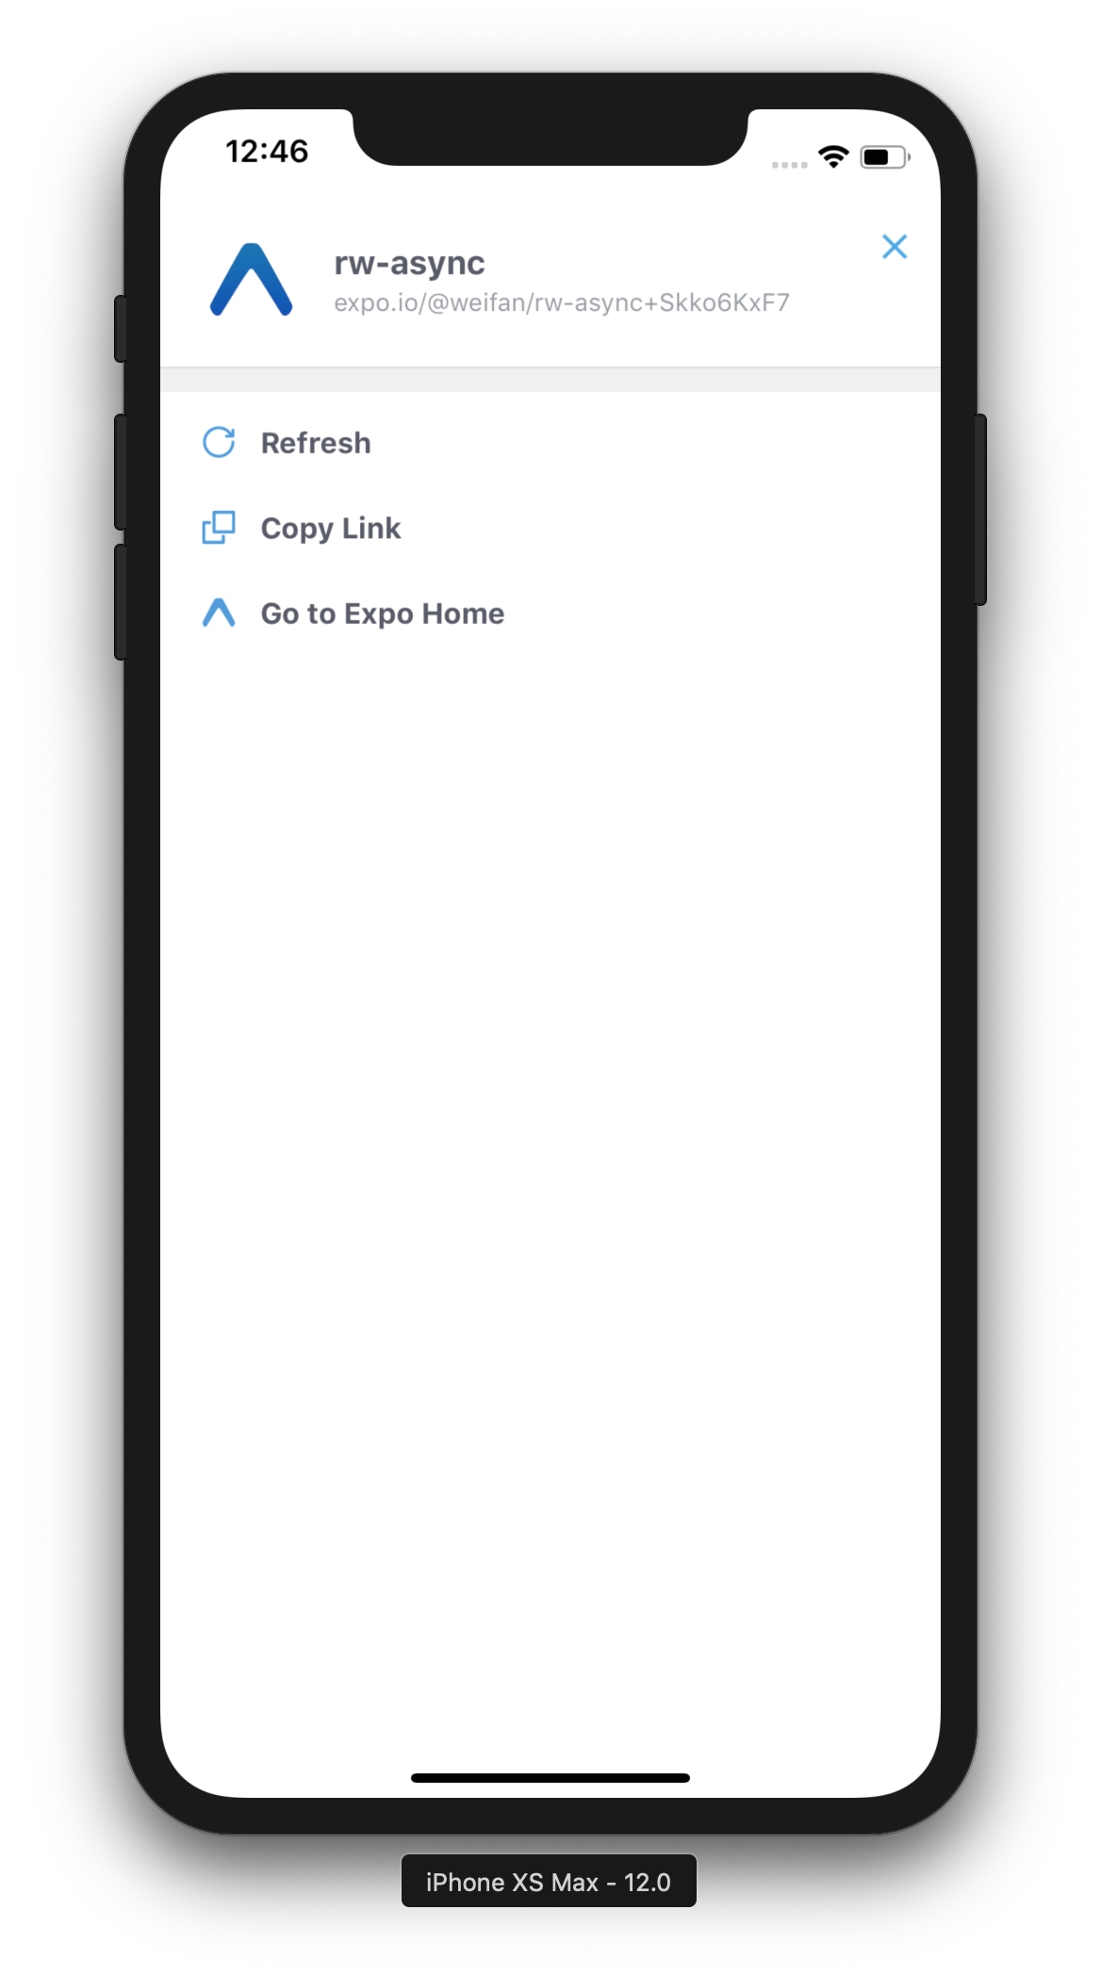
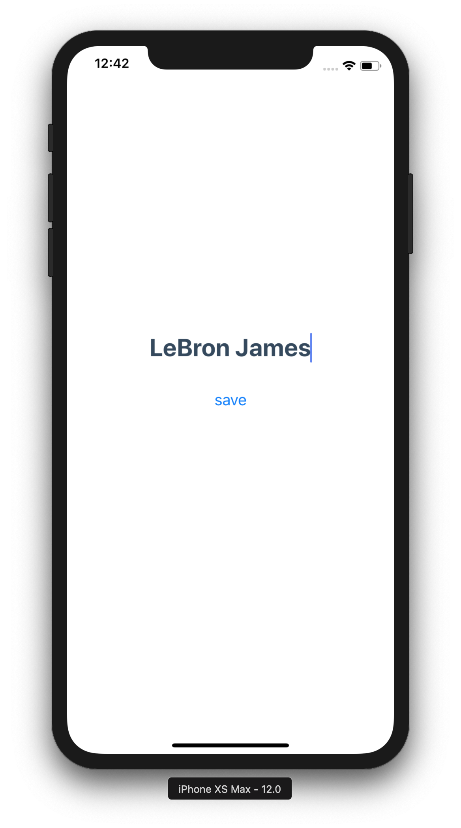
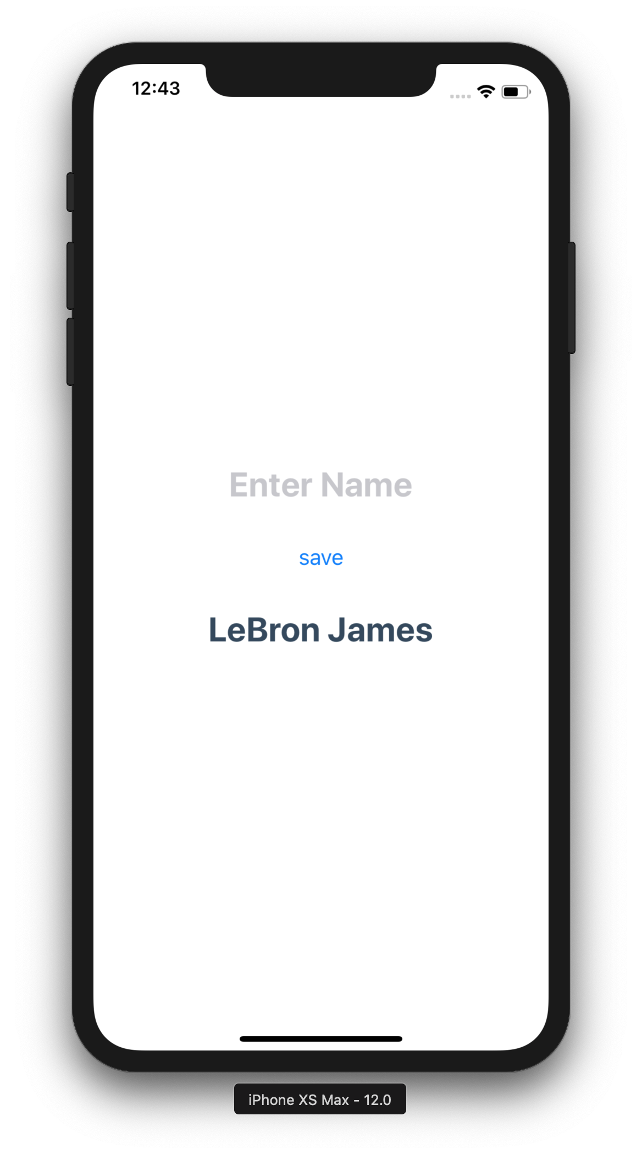
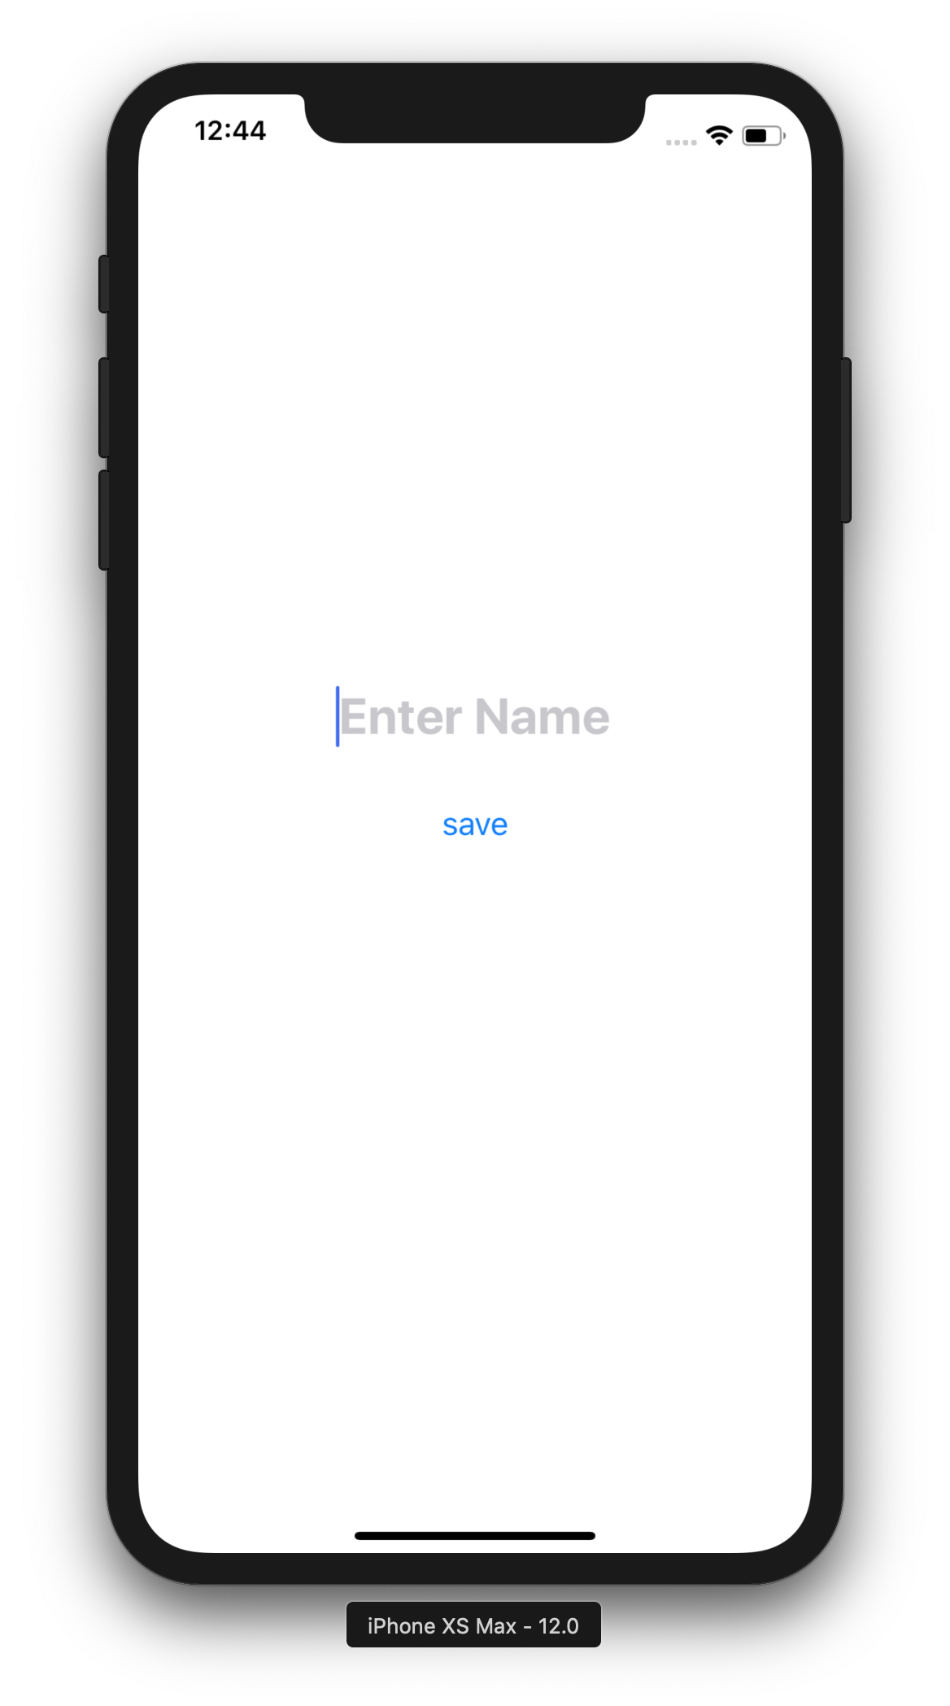
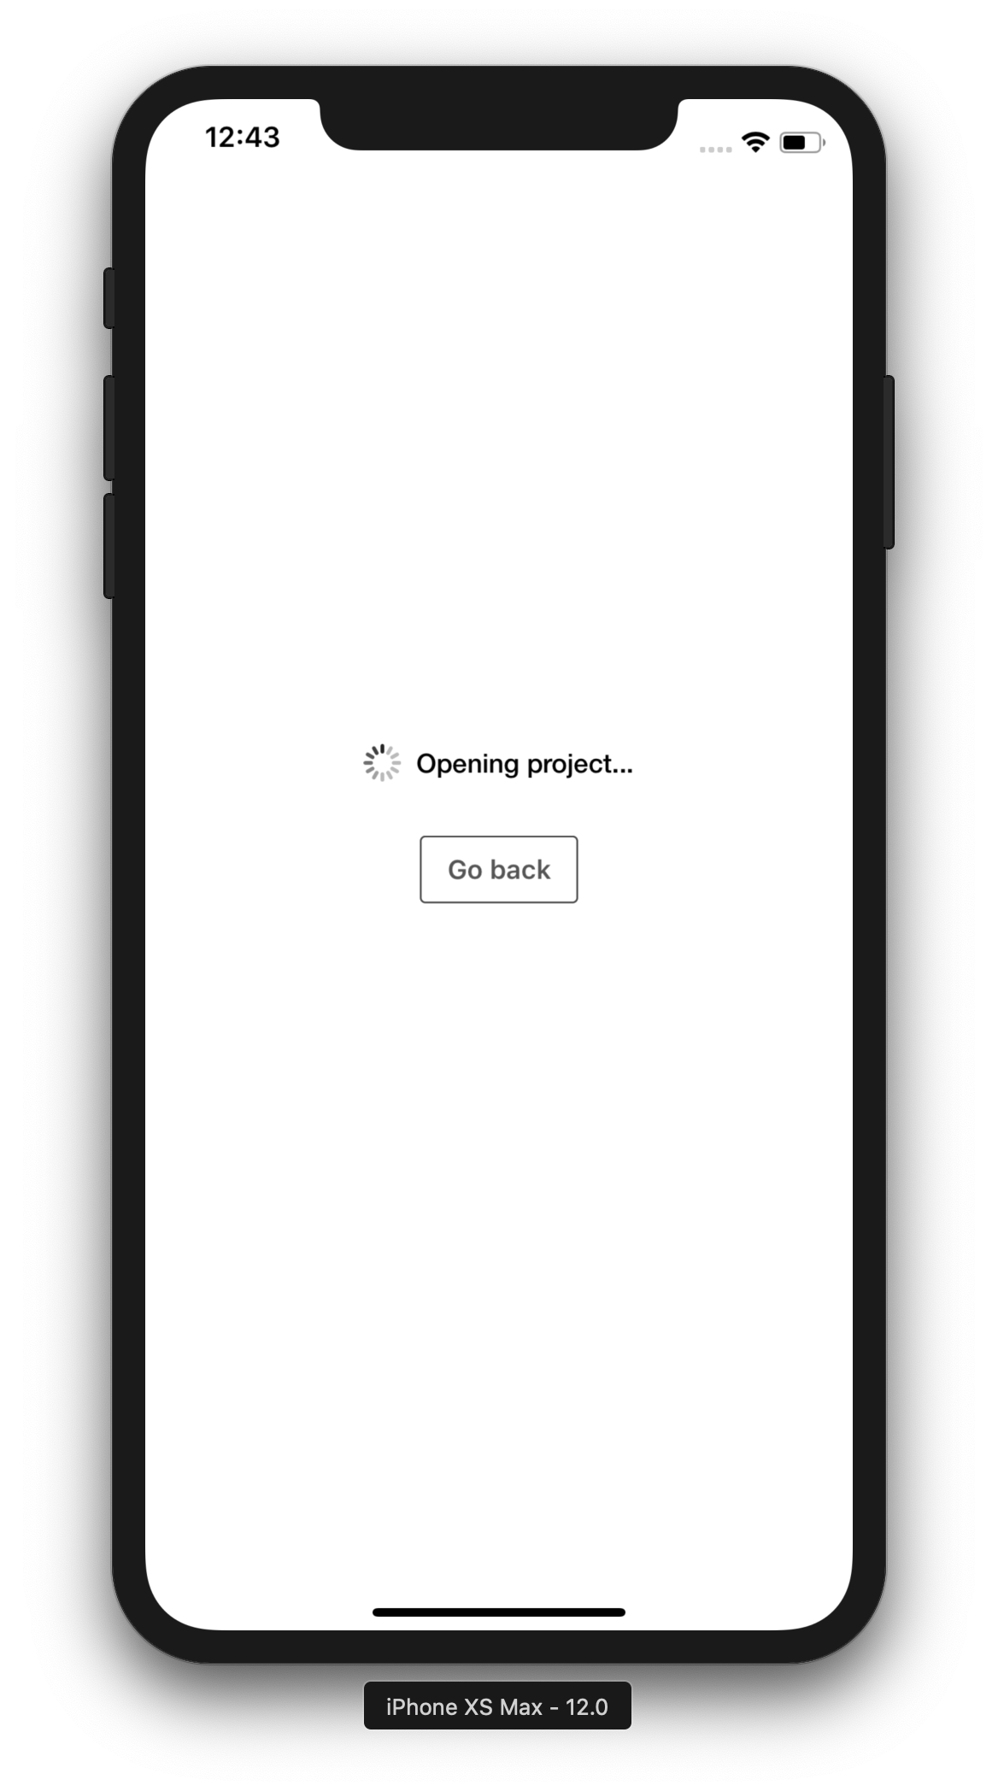
componentDidMount() {
AsyncStorage.getItem('nameDB').then((nameJSON) => {
this.setState({
nameStored: JSON.parse(nameJSON)
})
})
}
save = (name) => {
AsyncStorage.setItem('nameDB', JSON.stringify(name))
}
state = {
nameStored: ’’,
name: ''
}
onSave = () => {
this.setState({
nameStored: this.state.name,
name: ’’
})
this.save(this.state.name)
}
onChangeText = (text) => {
this.setState({
name: text
})
}
componentDidMount() {
AsyncStorage.getItem('nameDB').then((nameJSON) => {
this.setState({
nameStored: JSON.parse(nameJSON)
})
})
}
save = (name) => {
AsyncStorage.setItem('nameDB', JSON.stringify(name))
}
state = {
nameStored: ’’,
name: ''
}
onSave = () => {
this.setState({
nameStored: this.state.name,
name: ’’
})
this.save(this.state.name)
}
onChangeText = (text) => {
this.setState({
name: text
})
}
componentDidMount() {
AsyncStorage.getItem('nameDB').then((nameJSON) => {
this.setState({
nameStored: JSON.parse(nameJSON)
})
})
}
save = (name) => {
AsyncStorage.setItem('nameDB', JSON.stringify(name))
}
state = {
nameStored: ’’,
name: ''
}
onSave = () => {
this.setState({
nameStored: this.state.name,
name: ’’
})
this.save(this.state.name)
}
onChangeText = (text) => {
this.setState({
name: text
})
}
componentDidMount() {
AsyncStorage.getItem('nameDB').then((nameJSON) => {
this.setState({
nameStored: JSON.parse(nameJSON)
})
})
}
save = (name) => {
AsyncStorage.setItem('nameDB', JSON.stringify(name))
}
state = {
nameStored: ’’,
name: ''
}
onSave = () => {
this.setState({
nameStored: this.state.name,
name: ’’
})
this.save(this.state.name)
}
onChangeText = (text) => {
this.setState({
name: text
})
}
componentDidMount() {
AsyncStorage.getItem('nameDB').then((nameJSON) => {
this.setState({
nameStored: JSON.parse(nameJSON)
})
})
}
save = (name) => {
AsyncStorage.setItem('nameDB', JSON.stringify(name))
}
state = {
nameStored: ’’,
name: ''
}
onSave = () => {
this.setState({
nameStored: this.state.name,
name: ’’
})
this.save(this.state.name)
}
onChangeText = (text) => {
this.setState({
name: text
})
}
componentDidMount() {
AsyncStorage.getItem('nameDB').then((nameJSON) => {
this.setState({
nameStored: JSON.parse(nameJSON)
})
})
}
save = (name) => {
AsyncStorage.setItem('nameDB', JSON.stringify(name))
}
state = {
nameStored: ’’,
name: ''
}
onSave = () => {
this.setState({
nameStored: this.state.name,
name: ’’
})
this.save(this.state.name)
}
onChangeText = (text) => {
this.setState({
name: text
})
}
componentDidMount() {
AsyncStorage.getItem('nameDB').then((nameJSON) => {
this.setState({
nameStored: JSON.parse(nameJSON)
})
})
}
save = (name) => {
AsyncStorage.setItem('nameDB', JSON.stringify(name))
}
state = {
nameStored: ’’,
name: ''
}
onSave = () => {
this.setState({
nameStored: this.state.name,
name: ’’
})
this.save(this.state.name)
}
onChangeText = (text) => {
this.setState({
name: text
})
}
<View style={styles.view}>
<TextInput
style={styles.text}
placeholder='Enter Name’
onChangeText={this.onChangeText}
/>
<Button
title="save”
onPress={this.onSave}
/>
<Text style={styles.text}>
{this.state.nameStored}
</Text>
</View>
<View style={styles.view}>
<TextInput
style={styles.text}
placeholder='Enter Name’
onChangeText={this.onChangeText}
/>
<Button
title="save”
onPress={this.onSave}
/>
<Text style={styles.text}>
{this.state.nameStored}
</Text>
</View>
<View style={styles.view}>
<TextInput
style={styles.text}
placeholder='Enter Name’
onChangeText={this.onChangeText}
/>
<Button
title="save”
onPress={this.onSave}
/>
<Text style={styles.text}>
{this.state.nameStored}
</Text>
</View>
<View style={styles.view}>
<TextInput
style={styles.text}
placeholder='Enter Name’
onChangeText={this.onChangeText}
/>
<Button
title="save”
onPress={this.onSave}
/>
<Text style={styles.text}>
{this.state.nameStored}
</Text>
</View>
<View style={styles.view}>
<TextInput
style={styles.text}
placeholder='Enter Name’
onChangeText={this.onChangeText}
/>
<Button
title="save”
onPress={this.onSave}
/>
<Text style={styles.text}>
{this.state.nameStored}
</Text>
</View>
<View style={styles.view}>
<TextInput
style={styles.text}
placeholder='Enter Name’
onChangeText={this.onChangeText}
/>
<Button
title="save”
onPress={this.onSave}
/>
<Text style={styles.text}>
{this.state.nameStored}
</Text>
</View>
Notes:
import * as React from 'react’;
import { Text, View, AsyncStorage, TextInput, Button} from 'react-native’;
import styles from'./Styles'
export default class App extends React.Component {
componentDidMount() {
AsyncStorage.getItem('nameDB')
.then((nameJSON) => {
this.setState({
nameStored: JSON.parse(nameJSON)
})
})
}
save = (name) => {
AsyncStorage.setItem('nameDB', JSON.stringify(name))
}
state = {
nameStored: '',
name: ''
}
onSave = () => {
this.setState({
nameStored: this.state.name,
name: ''
})
this.save(this.state.name)
}
onChangeText = text => {
this.setState({
name: text
})
}
render() {
return(
<View style={styles.view}>
<TextInput
style={styles.text}
placeholder='Enter Name'
onChangeText={this.onChangeText}
/>
<Button title="save” onPress={this.onSave} />
<Text style={styles.text}>
{this.state.nameStored}
</Text>
</View>
);
}
}

Slide 27
Navigation

Slide 28
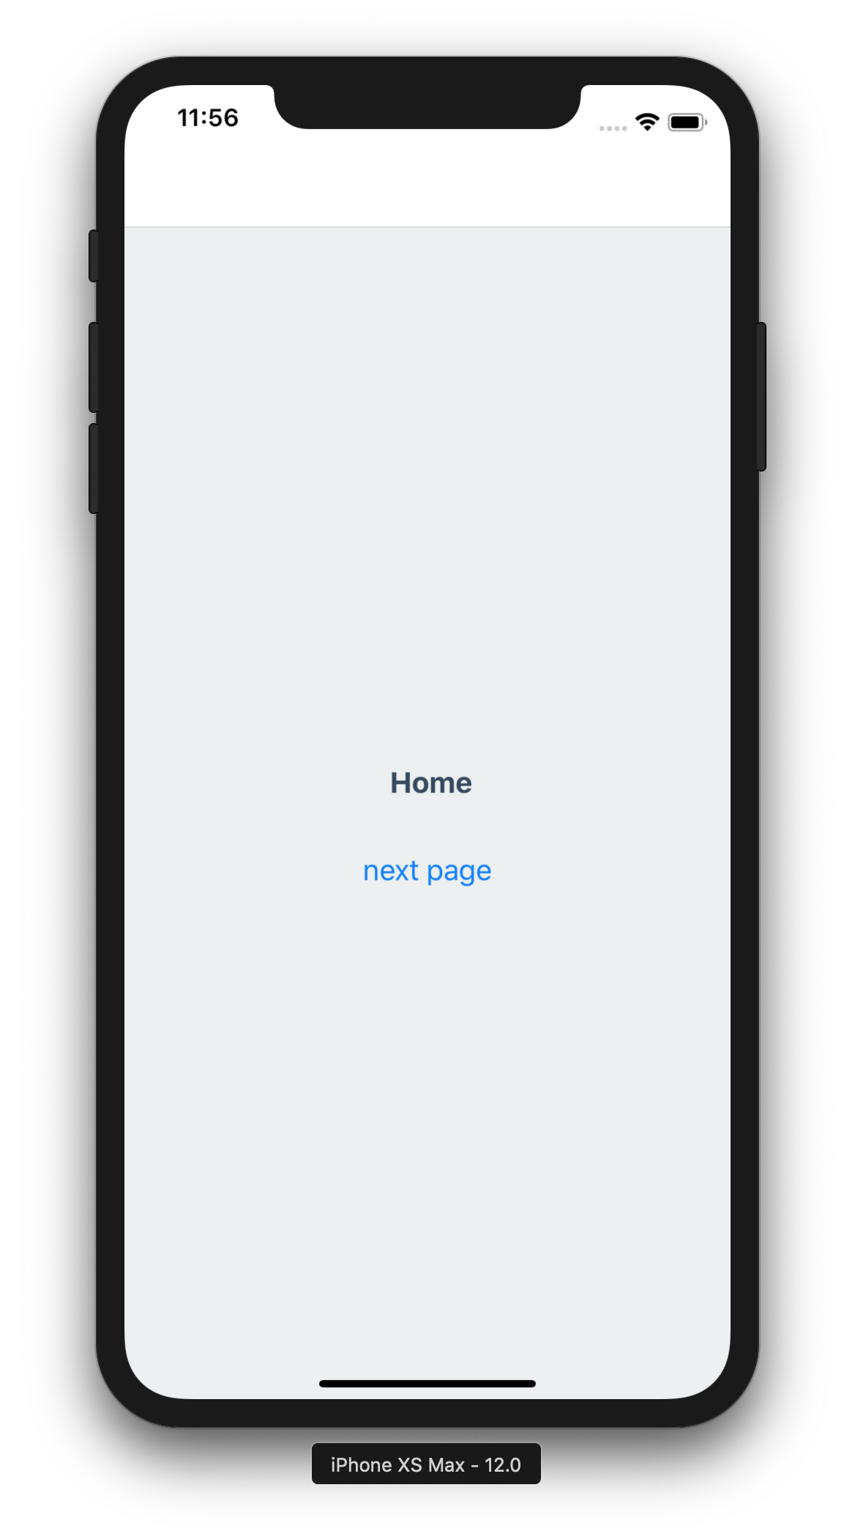
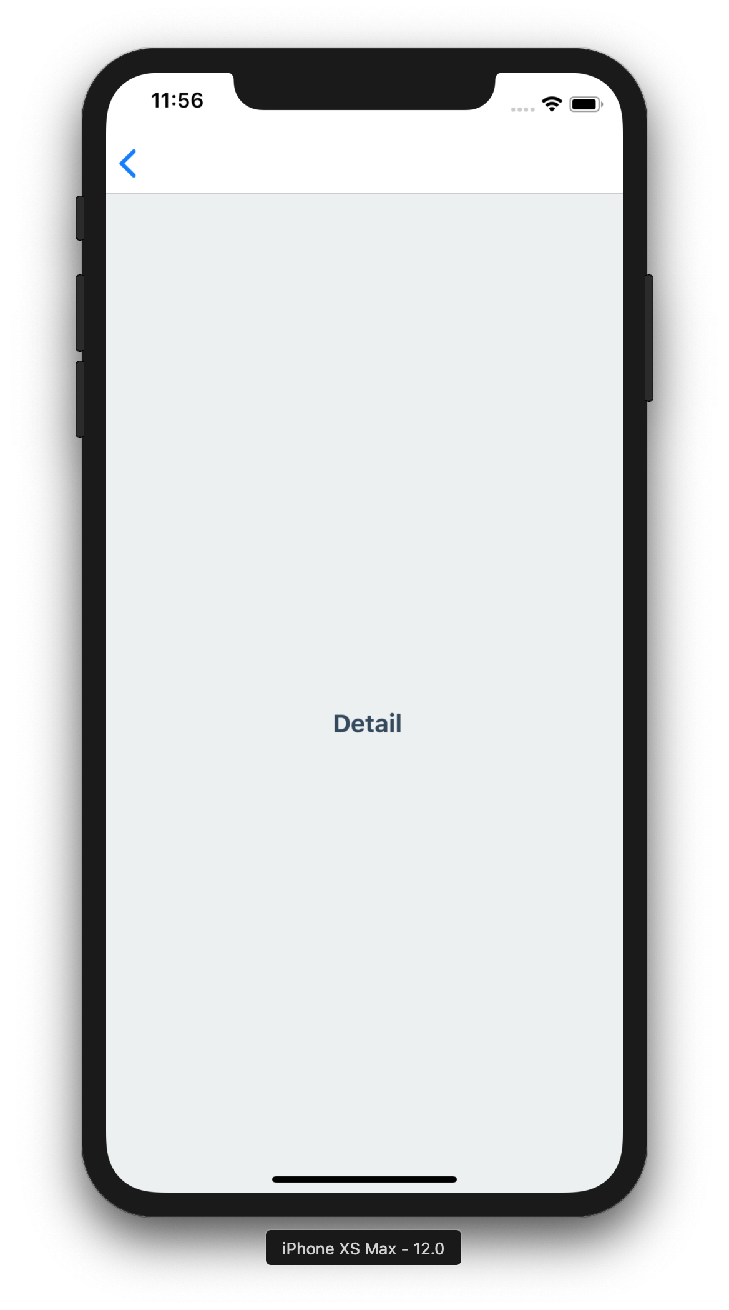
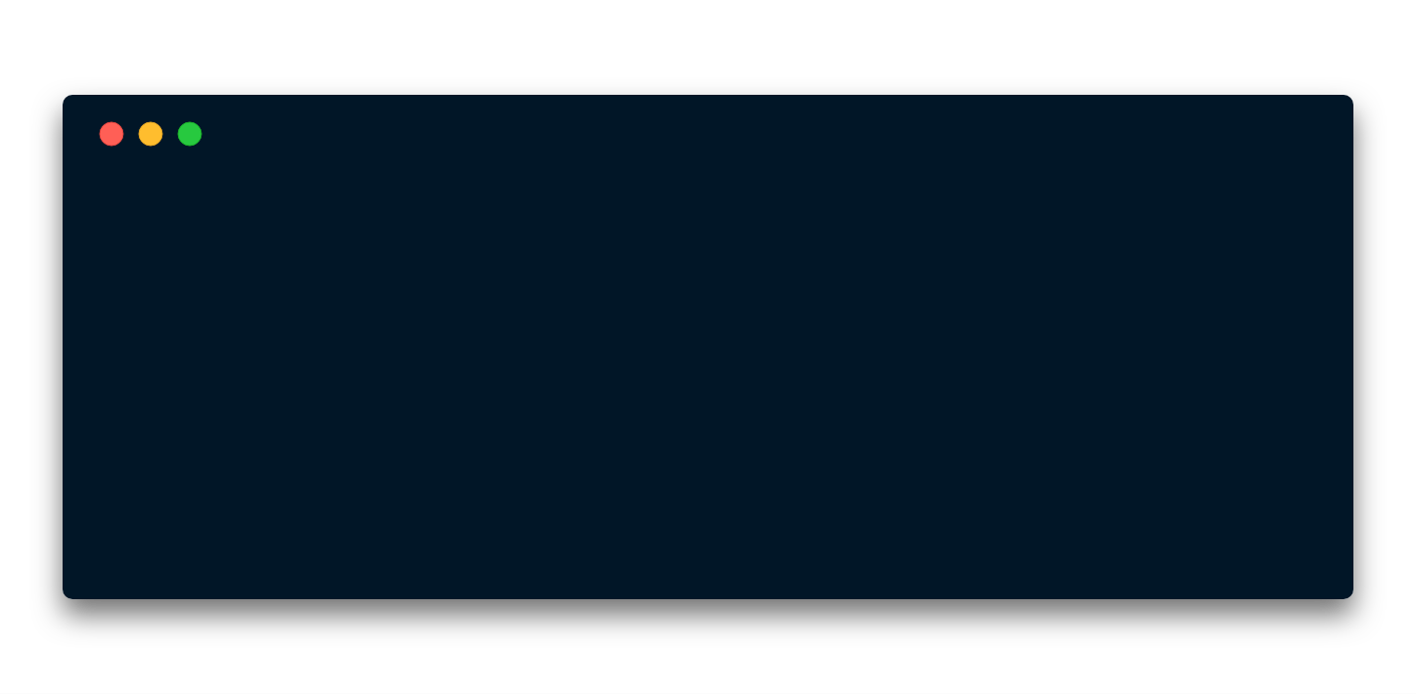
import * as React from 'react’;
import home from './Home’
import detail from './Detail’
import { createStackNavigator } from 'react-navigation';
const RootStack = createStackNavigator(
{
Home: home,
Detail: detail
},
{
initialRouteName: ’Home’,
}
)
export default class App extends React.Component {
render() {
return <RootStack/>
}
}
import * as React from 'react’;
import home from './Home’
import detail from './Detail’
import { createStackNavigator } from 'react-navigation';
const RootStack = createStackNavigator(
{
Home: home,
Detail: detail
},
{
initialRouteName: ’Home’,
}
)
export default class App extends React.Component {
render() {
return <RootStack/>
}
}
import * as React from 'react’;
import home from './Home’
import detail from './Detail’
import { createStackNavigator } from 'react-navigation';
const RootStack = createStackNavigator(
{
Home: home,
Detail: detail
},
{
initialRouteName: ’Home’,
}
)
export default class App extends React.Component {
render() {
return <RootStack/>
}
}
import * as React from 'react’;
import home from './Home’
import detail from './Detail’
import { createStackNavigator } from 'react-navigation';
const RootStack = createStackNavigator(
{
Home: home,
Detail: detail
},
{
initialRouteName: ’Home’,
}
)
export default class App extends React.Component {
render() {
return <RootStack/>
}
}
import * as React from 'react’;
import home from './Home’
import detail from './Detail’
import { createStackNavigator } from 'react-navigation';
const RootStack = createStackNavigator(
{
Home: home,
Detail: detail
},
{
initialRouteName: ’Home’,
}
)
export default class App extends React.Component {
render() {
return <RootStack/>
}
}
<Button
title="next page"
onPress={()=>
this.props.navigation
.navigate('Detail’)
}
/>
<Button
title="next page"
onPress={()=>
this.props.navigation
.navigate('Detail’)
}
/>
<Button
title="next page"
onPress={()=>
this.props.navigation
.navigate('Detail’)
}
/>
Notes:
import * as React from 'react’;
import { Text, View, AsyncStorage, TextInput, Button} from 'react-native’;
import styles from'./Styles'
export default class App extends React.Component {
componentDidMount() {
AsyncStorage.getItem('nameDB')
.then((nameJSON) => {
this.setState({
nameStored: JSON.parse(nameJSON)
})
})
}
save = (name) => {
AsyncStorage.setItem('nameDB', JSON.stringify(name))
}
state = {
nameStored: '',
name: ''
}
onSave = () => {
this.setState({
nameStored: this.state.name,
name: ''
})
this.save(this.state.name)
}
onChangeText = text => {
this.setState({
name: text
})
}
render() {
return(
<View style={styles.view}>
<TextInput
style={styles.text}
placeholder='Enter Name'
onChangeText={this.onChangeText}
/>
<Button title="save” onPress={this.onSave} />
<Text style={styles.text}>
{this.state.nameStored}
</Text>
</View>
);
}
}

Slide 29
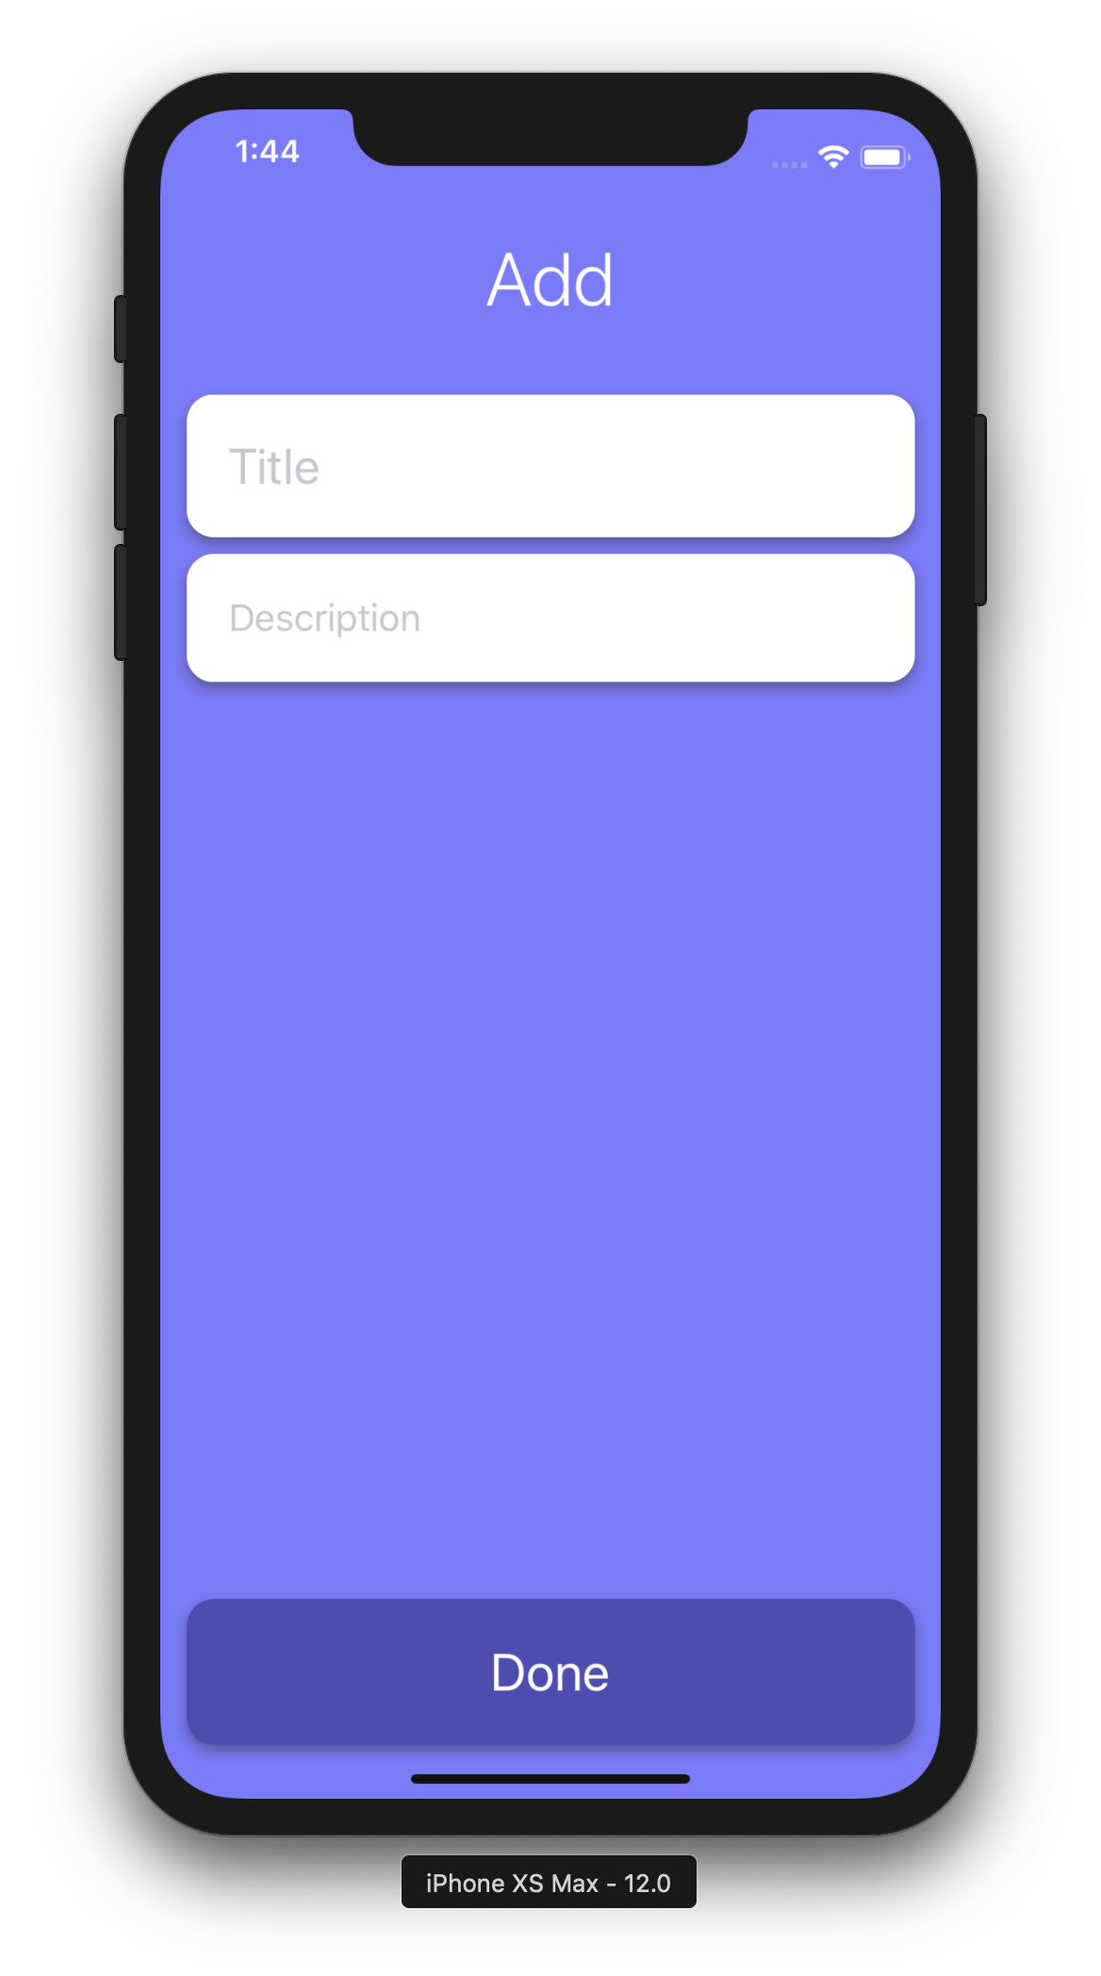
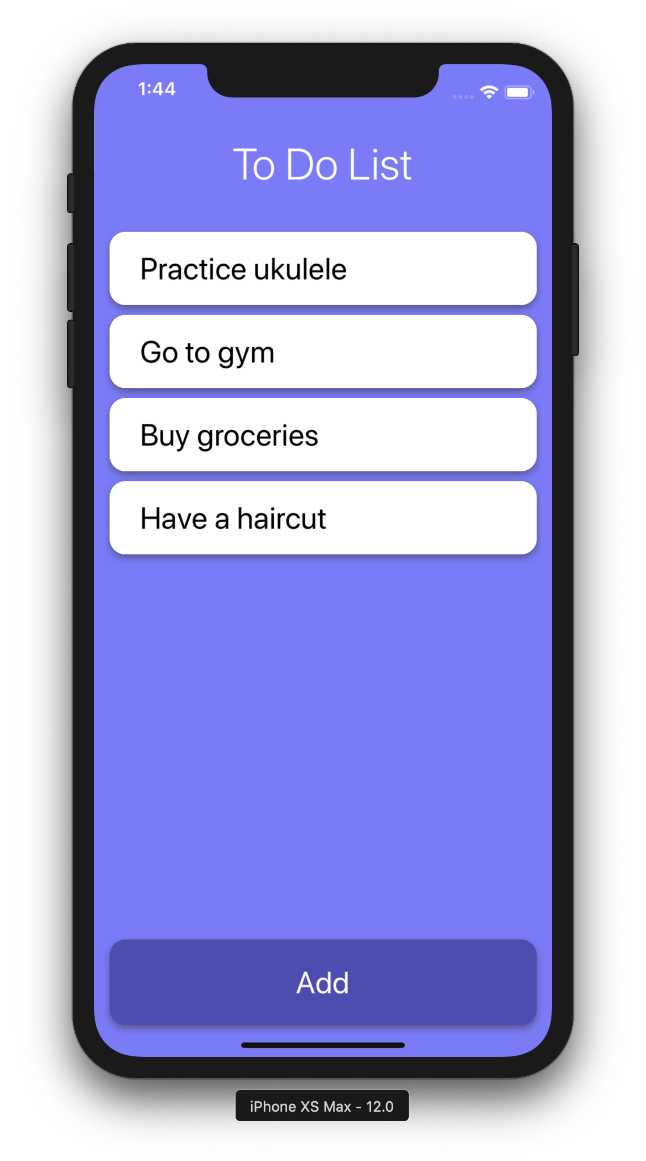
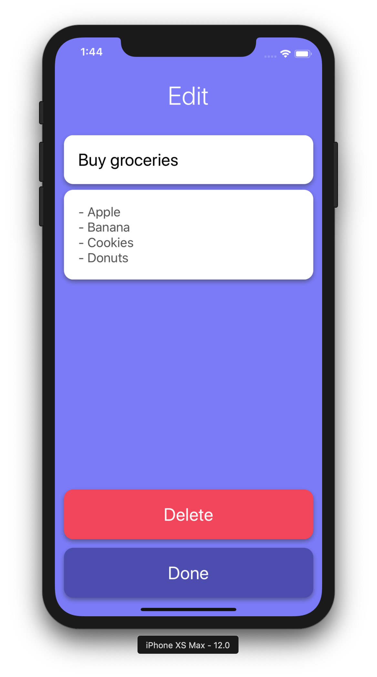
Activity: To Do List

